Slide 1



Reporting & Recording

Slide 2
The importance of good record keeping
Record keeping makes the continuity of care easier
Record keeping promotes better communication of information between members of the team
Helps to address complaints
Supports clinical audit & planning;
Helps to identify risks and enables the early detection of complications
Supports patient care and patient-centred communication
Helps improve accountability;
Shows how decisions were made relating to the clients care
Documentation is a legal a requirement

Slide 3
Common Mistakes
An absence of clarity
Inaccuracies
Spelling mistakes
Missing information
Failure to record action taken when a problem has been identified.
(Dimond 2005)
Benefits of Good Record Keeping
Record keeping is a tool for professional practice and one that should help the care process.
It’s important that accurate records are made for every client and should include interventions and any response to the interventions.

Slide 4
“Failing to keep accurate records of decisions you have made and actions you have taken can put people at risk.”
(Social Care Institute for Excellence, 2015)

Slide 5
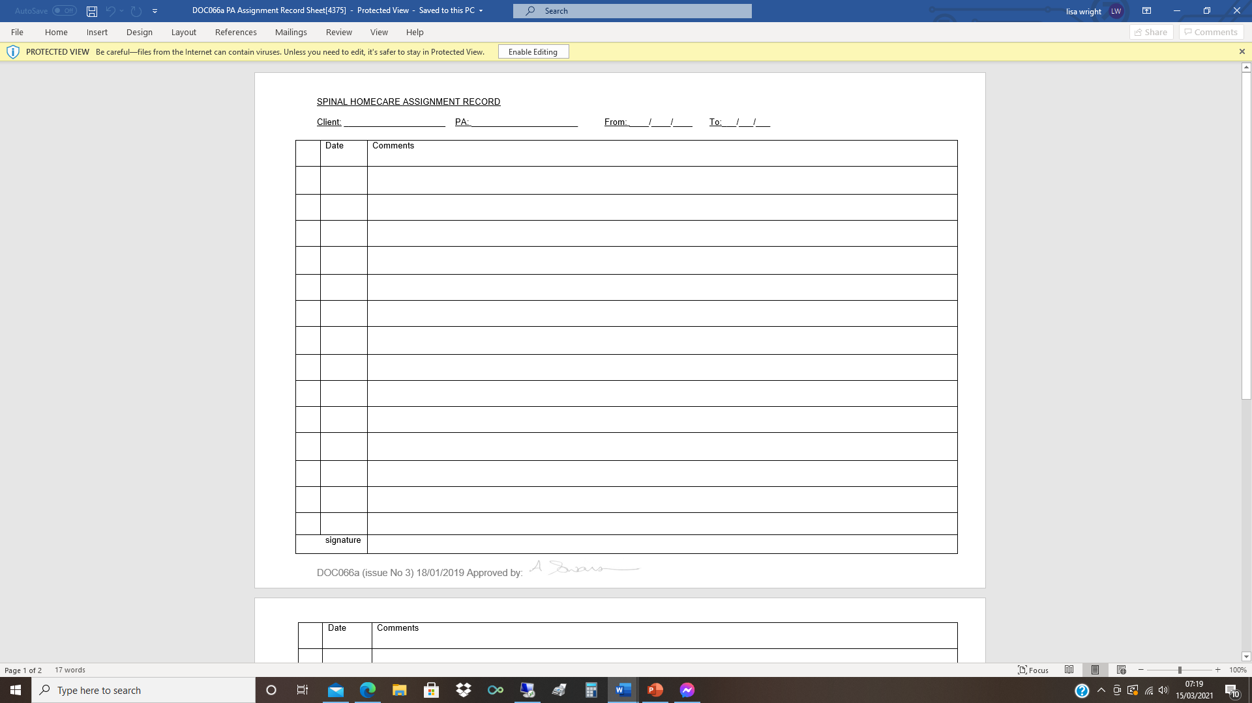
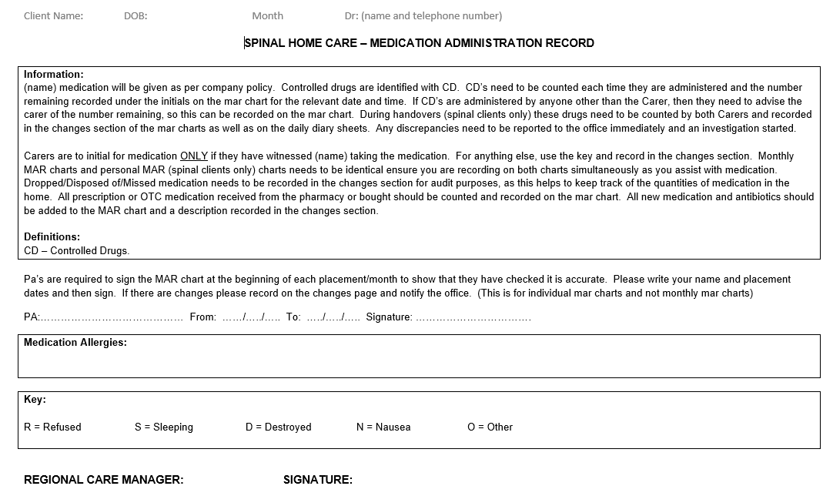
You will be Completed Daily :
Daily Care Sheet
Medication charts
Ordering Medication
Handover
Body Map

Slide 6
What to record ?
Daily Care Carried Out
District Nurse or GP Visits
Nutrition & Hydration
Pressure/Skin Area Checks
Outcome of Bowel/Bladder Routines
AD & Postural Hypertension
Accidents & Near Misses

Slide 7
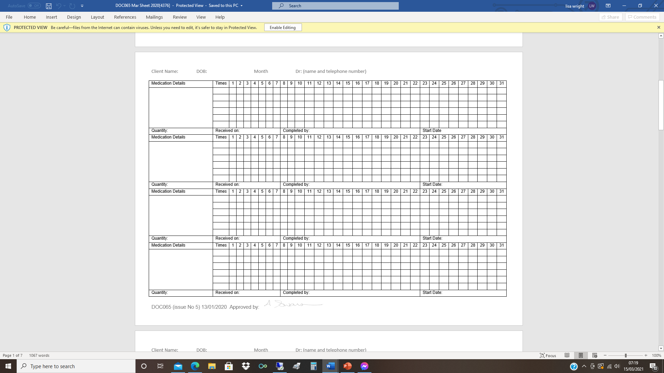
Medication Administration

Slide 8
The Six Rights When you are giving medication, regardless of the type of medication, you must always follow the six rights. Each time you administer a medication, you need to be sure to have the:
Right individual
Right medication
Right dose
Right time
Right route
Right documentation
Each time you give a medication, you must systematically and conscientiously check your procedure against these six rights.
This is essential every time you administer any medication – including medications that an individual has been taking for a long time.
You must check for all six rights every time you administer any drug to any individual

Slide 9
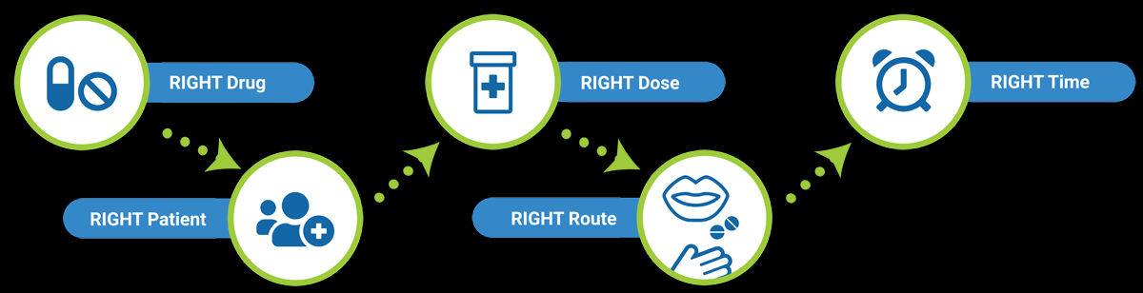
RIGHT TO REFUSE

Slide 10
Activity 2
How to amend a MAR Chart (Medication Administration Record)
Consider the items listed below and show on the MAR Chart how you would record these changes on the medication section and in the changes section. Your placement started on the 7th and ended on the 15th of the month. Sign and amend the MAR chart, you arrive at the client’s home at 12pm on the 7th and leave at 2pm on the 15th. Client A went to the see the GP on the 9th at 11am and had a review of his medication and changes were made. Amend on the Mar Chart included.
1. Sodium Docusate (100mg) was discontinued on the 10th.
2. Baclofen (10mg x 2) of daily dose has been decreased to 2x daily so the times it’s administered have changed to 10.00 and 18.00 starting on the 10th.
3. Client A had to reorder Glycerine suppositories and there are 28 to a box and he has received 3 boxes which arrived on the 8th.
4. Baclofen (10mg) there are 28 to a box and during your placement you had to open a new box on the 13th.
5. Client A has been prescribed antibiotics for a chest infection, amoxicillin 500mg for 7days from the 10th to the 16th, administered at 10.00 and 22.00.
6. Oxynorm (5mg) is a CD (controlled drug) before leaving the placement you have to count the tablets and record how many are left. There is 1 unopened box with 28 tablets and an opened box with 5 tablets left on the strip.
7. Client A is out with a friend and gave the client his medication that is due on the 14th at 22.00.

Slide 11
Spinal Homecare – Induction Sheet (Tick and sign sheet) ASSIGNMENT RECORDS – (Changeover, handover) own and monthly | ✓
MEDICAL SHEETS own and monthly | ✓
EXPENSES (use the cheapest form of travel) | ✓
REVIEW SHEETS (Client and carer) | ✓
CONTRACTS: CCM and Respite. Respite clients pay your travel directly To you, speak to them before buying your ticket. Always ring the client 2 days before the placement starts, and keep your phone switched on (silent). Do not use your phone in front of your client. | ✓
FINANCIAL TRANSACTIONS (Client finances) | ✓
FOOD ALLOWANCE (on some placements) will say on the profile. PERSONAL HYGEINE and suitable clothing. No long/false nails. ALCOHOL (Not to be consumed under any circumstances) OR drugs which may impair you ability to do your job safely. | ✓
SKIN MARKS: ALWAYS ring the office if you see a mark on the skin. | ✓
DRIVING – (Driving is essential) Parking tickets, speeding tickets, points and accidents (carer responsibility) don’t park in disabled, if your client is not with you. (no good saying you don’t want to drive in London) | ✓
TRAVEL – (Expected time of arrival, ask client directions from the station, NEVER leave client until the next carer arrives) | ✓
MONEY SUBS – (Money subs are available to new carers and in emergencies Only) (ONLY for the first 6 weeks). | ✓
CLIENT / CARER RELATIONSHIPS (Our motto is “your life, your way”) | ✓
ON-CALL PHONE- Should you need to contact the member of staff on-call Phone and speak to someone. Do not send texts. | ✓
PAY ROLL – (Wages 20th-20th) from 12.00 noon day 1 – 12.00 noon day 2 etc. PAYDAY is the 30th of every month or if the 30th falls on a weekend it will be paid the Friday before. | ✓
SUPERVISION – (QCF Diploma’s and Office support) | ✓
TIME OFF – (Your availability well in advance) (accidents and sickness) | ✓
WORK – (Time off at the discretion of the client) (Work 8 hours daily) | ✓
ON CALL SYSTEM. You are actually under contract whilst on call, so NO alcohol or drugs which may impair your ability to do your job safely. You must call the office if you become ill whilst on call, as you would if you were with a client, then we will replace the on call carer. | ✓
CARE PLANS (ISO and CARE STANDARDS) | ✓
I HAVE RECEIVED MY CONTRACT. | ✓

Slide 12



