Slide 1

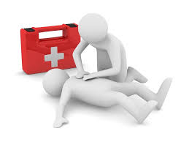
First Aid

Slide 2



First Aid
First Aid is the initial assistance or treatment given to a person who is injured or suddenly taken ill.
Information has been taken from St John’s Ambulance, the Spinal Cord Injuries Association & NHS24.
Source: NHS 24

Slide 3
Recovery Position
If a person is unconscious but is breathing and has no other life-threatening conditions, they should be placed in the recovery position.
Putting someone in the recovery position will keep their airway clear and open. It also ensures that any vomit or fluid won't cause them to choke.
Or you can follow these steps:
with the person lying on their back, kneel on the floor at their side
place the arm nearest you at a right angle to their body with their hand upwards, towards the head
tuck their other hand under the side of their head, so that the back of their hand is touching their cheek
bend the knee farthest from you to a right angle
carefully roll the person onto their side by pulling on the bent knee
the top arm should be supporting the head and the bottom arm will stop you rolling them too far
open their airway by gently tilting their head back and lifting their chin, and check that nothing is blocking their airway
stay with the person and monitor their condition until help arrives
Source: NHS 24

Slide 4
Hands Only CPR
To carry out a chest compression:
Place the heel of your hand on the breastbone at the centre of the person’s chest. Place your other hand on top of your first hand and interlock your fingers
Position yourself with your shoulders above your hands
Using your body weight (not just your arms), press straight down by 5-6cm (2-2.5 inches) on their chest
Keeping your hands on their chest, release the compression and allow the chest to return to its original position
Repeat these compressions at a rate of 100 to 120 times per minute until an ambulance arrives or you become exhausted
When you call for an ambulance, telephone systems now exist that can give basic life-saving instructions, including advice about CPR. These are now common and are easily accessible with mobile phones.
Source: NHS 24

Slide 5
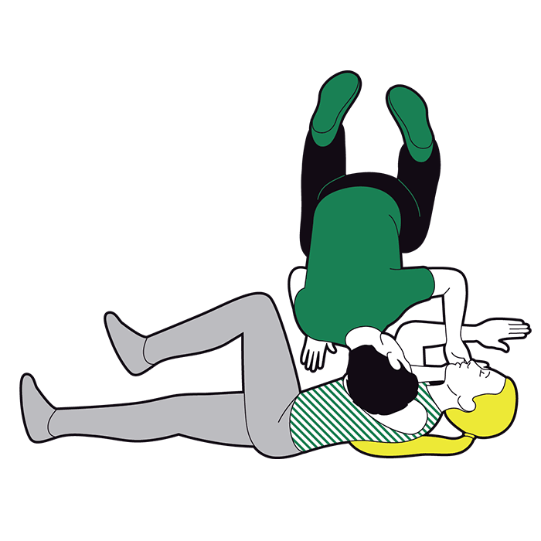
You will now be shown 2 videos from St Johns Ambulance
How to place someone unresponsive in the recovery position & how to preform CPR
https://youtu.be/GmqXqwSV3bo
https://youtu.be/BQNNOh8c8ks

Slide 6
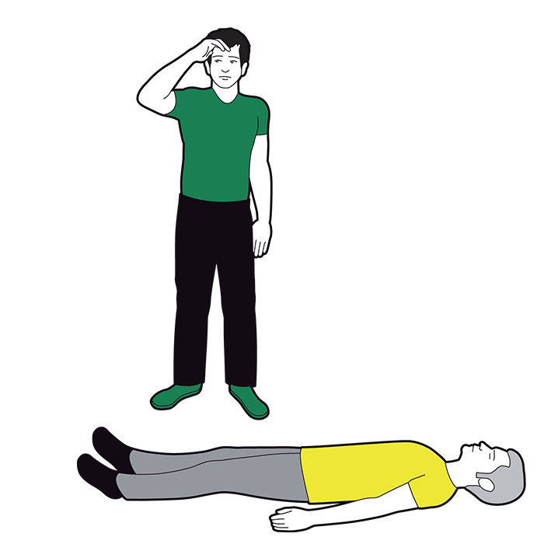
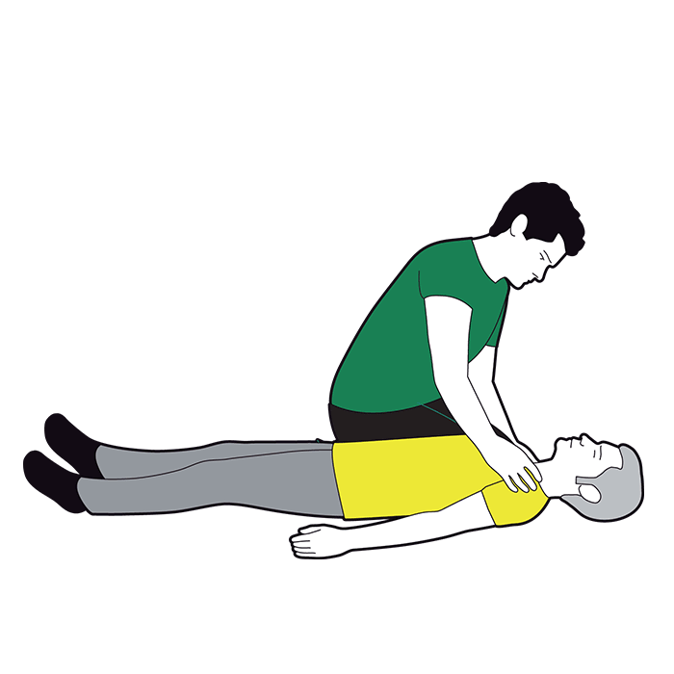
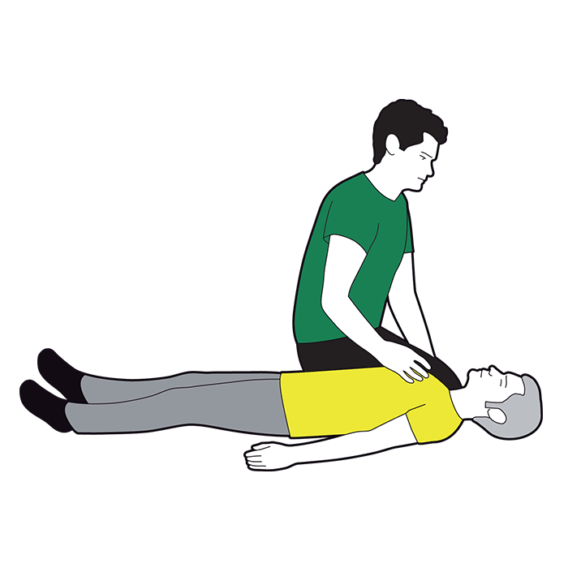
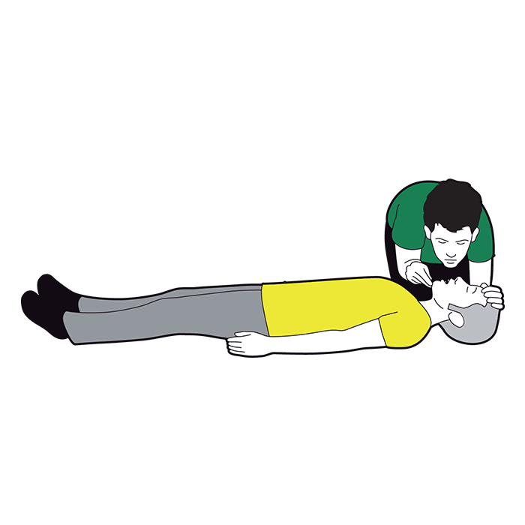
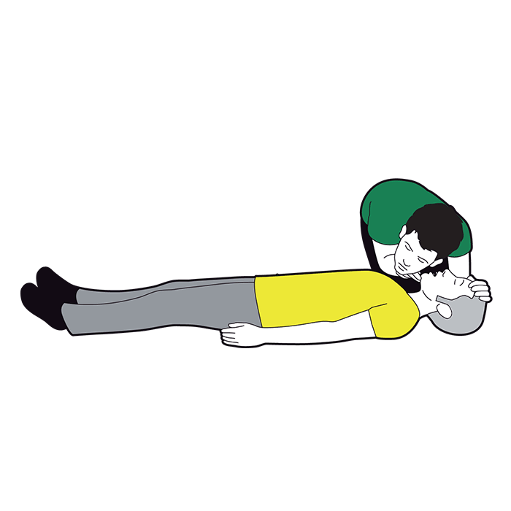
How to do the primary survey (DR ABC)
Danger.
Response.
Airway.
Breathing.
Circulation.

Slide 7
Danger. Before approaching the casualty, always make sure the area is safe.
Response. Check if the casualty is responsive or unresponsive. As you approach them, introduce yourself and ask them questions to see if you can get a response. Kneel next to their chest and gently shake their shoulders, asking, ‘What has happened?’, ‘Open your eyes!’.
If the casualty opens their eyes, or gives another gesture, they are responsive.
If they do not respond to you in any way they are unresponsive and should be treated as quickly as possible.
Airway. Next, you need to check that the airway is open and clear. Open the airway by placing one hand on the forehead to tilt the head back and use two fingers from the other hand to lift the chin.
If they are unresponsive, you need to move on to breathing as quickly as possible.

Slide 8
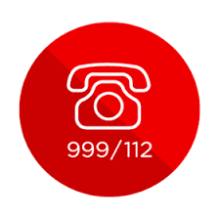
Breathing. You now need to check if the casualty is breathing normally. Place your ear above their mouth, looking down their body. Listen for sounds of breathing and see if you can feel their breath on your cheek. Watch to see if their chest moves. Do this for 10 seconds.
If they are unresponsive and not breathing, you need to call 999/112 for emergency help and start CPR straight away. Ask a helper to find and bring a defibrillator (AED).
If they are responsive and breathing move on to circulation.
Circulation. Once you have established they are breathing, look and check for any signs of Severe Bleeding.
If they are bleeding severely you will need to control and treat the bleeding by applying direct pressure to the wound. Call 999/112 for emergency help.
If they are unresponsive and breathing but with no bleeding, put them in the Recovery Position and call 999/112 for emergency help.

Slide 9
What kind of injuries and conditions might occur in your care setting?
Cuts UTI Water Infection
Bruises Postural Hypertension
Slip, Trips, Falls Muscle Spasm
Burns & Scalds Autonomic Dysreflexia
Choking Chest Infections

Slide 10
Choking Adult
What to look for ?
If you think someone is choking, ask them: ‘Are you choking?’ to check they’re not suffering from something else.
Can they speak, cry, cough or breathe?
If they can, they should be able to clear their throat on their own by coughing, so encourage them to cough.
If they can’t cough or make any noise, it’s serious.
to look for

Slide 11
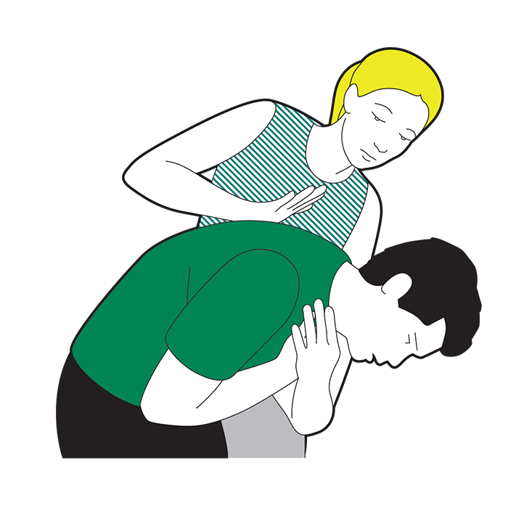
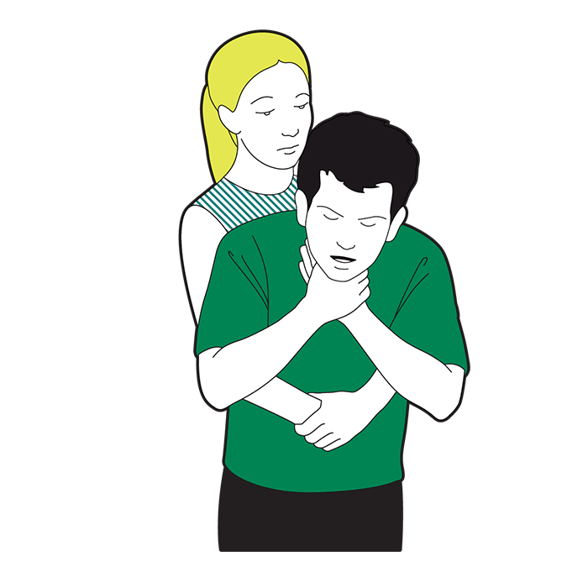
Choking Adult
What to do ?
Help the client to clear their throat with these steps
Cough it out
Encourage them to cough. If this doesn't clear the obstruction, support
their upper body with one hand and help them lean forward.
Slap it out
If coughing doesn’t work, help the client bend/lean forward.
Use the heel of your hand to give up to five sharp back blows between
their shoulder blades.
Check their mouth to see if there’s anything in there and, if there is, get
them to pick it out.

Slide 12
Squeeze it out
If back blows don’t work, give up to five abdominal thrusts. Standing behind them.
Link your hands between their tummy button and the bottom of their chest, with your lower hand clenched in a fist.
Pull sharply inwards and upwards.

Slide 13
Call for help
If they’re still choking, call 999 or 112 for medical help.
Once you’ve called, continue back blows and abdominal thrusts – until what’s in there has cleared, help arrives or they become unresponsive.
If they become unresponsive at any stage, open their airway and check their breathing.
If they’re not breathing, start chest compressions and rescue breaths (CPR - cardiopulmonary resuscitation) to try to release whatever’s stuck in there. Follow the instructions for treating someone who’s unresponsive and not breathing.

Slide 14
Postural Hypotension
Spinal cord injury can have a profound effect on all systems of the body including your cardiovascular system. You will probably find that your normal blood pressure is lower than it used to be. This can mean you can be susceptible to a condition known as postural hypotension
When we alter position, our blood vessels automatically respond to ensure consistent blood supply to our brains and major organs. Following spinal cord injury the feeling of faintness occurs because, as you sit up or change position, the vessels are slow to respond and blood can drain to the lower parts of the body. This leads to a drop in blood pressure (postural hypotension) making you feel faint.

Slide 15

Postural hypotension is a drop in blood pressure when moving from a flat to an upright position. If you have a high spinal cord injury, particularly T6 and above, you may experience a feeling of faintness or you may pass out briefly after moving too quickly, for example:
from lying down to sitting up in bed
Shortly after transferring into your wheelchair
When standing in a frame.

Slide 16
What To Do ?
• Elevate the back of the bed slowly, so that your client can sit up in bed in stages before getting into the wheelchair. If faintness occurs, lie down again, wait for a few minutes and then sit up slowly. Once sat up, wait 10-15 minutes before transferring into wheelchair.
• Once transferred to the wheelchair, elevate the footplates for a short period. If your client becomes faint in the wheelchair you could recline the backrest. If none of the above is possible and your client still feels faint, it may be necessary to put the brakes on and tilt the wheelchair backwards until your clients head and neck are nearly horizontal.
• Raise your clients legs
• Alternatively, it may be possible for your client to lean forward in their chair. Take special care that your client will not overbalance. It will be safer if they are wearing a lap belt.
• Some clients may use ted stockings or abdominal binders to lessen the effect of gravity on blood pressure. If they have ongoing problems from low blood pressure, recommend they speak to ther GP/doctor as medication can also help.
• Avoiding a large meal immediately before or after transfer into their wheelchair.
• Although most people only experience postural hypotension for a few weeks when they start getting up into a wheelchair for the first time, it can be persistent. It may also occur if you have been on bed rest for a period, for example, due to a pressure sore .

Slide 17

Muscle spasm
Most people with a spinal cord injury at or above T12 experience muscle spasm to some degree. A spasm is an uncontrolled contraction of muscles that occur spontaneously due to a reflex action. The reflex can be triggered when the muscles are stimulated to contract.
There are many ways this can happen including:
While moving the bed sheet gently
Moving when the client first wakes up
Lying down when getting back into bed (this stretches the muscles)
Pain or discomfort below the level of the injury, including pressure sores, infection or an injury to legs or feet
A full bladder or bowel

Slide 18
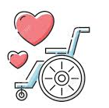
Each client has their own way of dealing with spasms. Ask the client to direct you in their preferred method.
There are drugs available to help control the spasms i.e. baclofen.
Some clients may have baclofen pumps which are inserted beneath the skin and refilled on a regular basis at the spinal unit.

Slide 19
Autonomic Dysreflexia (AD)
AD is also known as hyperreflexia, it is a condition unique to people with spinal cord lesions.
It is know to occur in 83-85% of people with spinal cord lesions at or above T6 i.e. tetraplegics and high level paraplegics.
It is considered to be a life threatening condition that requires immediate treatment; if uncontrolled, the client may need to seek emergency treatment.
AD occurs suddenly without warning.
It is the body’s response to a pain or discomfort below the level of the spinal cord lesion.

Slide 20

When the body feels pain or discomfort, the blood pressure (BP) rises.
This is detected by the nervous system, which then responds, via the autonomic nervous system, by lowering the BP to keep it within in the normal range.
When a client has a SCI at T6 or above, pain or discomfort below the level of the SCI causes the blood pressure to rise until the cause of the pain or discomfort is found and removed.
If an episode of AD is not resolved, the continuing rise in the clients blood pressure becomes dangerous and can lead to fitting, brain haemorrhage (stroke) and possibly death.
However, the autonomic nervous system does make an attempt to lower the BP above the SCI.
This provides the client with symptoms that you can look out for when AD occurs.

Slide 21
Causes of AD
Bladder related
• Bladder distension
• Urinary tract infection
• Bladder or kidney calculi
• Gallstones
Positioning related
• Tight clothing
• Sitting on scrotum
Gastric/Bowel related
• Constipation
• Gastric ulcers or gastritis
• Haemorrhoids
• Stomach upset
Skin related
• Pressure ulcers
• Ingrown toenail
• Burns or sunburn
• Blisters
• Insect bites
Reproductive system
• Sexual intercourse
• Ejaculation
• Menstruation
• Pregnancy, labour and delivery
Musculo- skeletal
• Fractures or other trauma
Other
• Surgery or procedures
• Any other continuous painful stimulus
Over distended (overfull) bladder (most common, 75%)
Over distended (overfull) rectum/bowel (second most common, 15%)

Slide 22
Symptoms of AD
Symptoms of AD Some or all of these symptoms may be present
Therefore if an individual is demonstrating any of these symptoms this may represent a dysreflexic episode.
Pounding Headache
Bradycardia (Slow heart rate)
High BP (tetraplegics have a lower blood pressure of 90/60mmHG, which is considered a new normal)
Flushing, redness and sweating of the skin above the level of your spinal cord
Cold, pale skin, goosebumps below the injury level
Nausea, nasal congestion,
blurred vision due to dilatation of pupils,
shortness of breath,
anxiety or a sense of apprehension

Slide 23
How To Treat AD
Treatment of Autonomic Dysreflexia AD will resolve when the cause of pain or irritation is removed.
Therefore the cause must be identified and resolved.
This requires immediate action.
Sit your client upright to help lower blood pressure with gravity
If the cause cannot be found or treated, medication must be administered to control blood pressure.
The client should have nifedipine 5-10mg which is used to lower the blood pressure. It comes in a capsule. Open the capsule and place the contents under the clients tongue. The client must swallow the empty capsule to ensure they get the full dose. Ensure you gain consent before giving your client medication.
Or a GTN spray, which is sprayed under the clients tongue

Slide 24
When AD occurs the first steps are to :
Sit your client upright to help lower blood pressure with gravity
Loosen tight clothing in case this is causing a painful stimulus.
Elevate the head of the bed
Put the back of the bed up or put several pillows to elevate the client, this will prevent the BP rising further.
Check the catheter
If the drainage bag is overfull drain the urine from the bag. If the bag is empty starting from the bag move up the tube looking for kinks and blockages.
Remove kinks and blockages.
To reduce the risk of the catheter blocking in the tube, squeeze (milking) the tube the whole way down to dislodge any sediment.
If there are no blockages but the catheter isn’t draining, push the catheter back into the body gently as it may be resting against the wall of the bladder.
If the catheter is still not draining, call the DN to change the catheter.
Offer the client nifedipine.

Slide 25
Check the bowel
using a lubricated gloved finger
insert the finger into the rectum
If the rectum is full, remove the faeces using a manual evacuation.
If the bowel is empty but feels large and the walls are smooth, this is gas/wind. Pull your finger to one side, this will open the rectum and allow the gas to escape.
Other causes
look for pressure marks, sores, ingrown toenails, cuts, abrasions, etc.
If the source of the AD is not found, the client will need to seek emergency medical assistance. An ambulance should be called, 999 or 112, and the client taken to hospital.

Slide 26
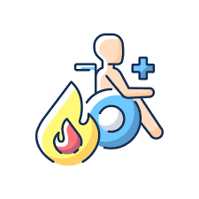
Burns and Scalds
How might a client receive burns or scalds?

Slide 27
Types and sign of burns and scalds
Burns are classified into three types:
Superficial (1st degree): involving only the external part of the outermost layer of skin.
Partial-thickness (2nd degree): involving the entire outer layer of skin.
Full-thickness burn (3rd degree): affecting all layers of the skin. **needs urgent medical attention
Signs
Red skin
Blistered and hot
Swollen and weeping fluid
Pain
tenderness
Pale and waxy, smell of charred flesh
Shock

Slide 28
How to Treat Burns & Scalds
Do not touch the burned area.
Leave any blisters intact
Hold under cool running water for at least 10 minutes
Remove any jewellery
Leave any clothing stuck to the burn
Cover with a sterile dressing, cling film makes a good temporary dressing.
Treat for shock
Do Not use any creams, fluffy/adhesive dressings or burst any blisters.

Slide 29
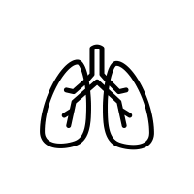
Chest Infections
If the client has a SCI in the thoracic or cervical region they are more susceptible to chest infections.
This is because the muscles in their abdomen and chest are partly or fully paralysed and their ability to breath deeply and cough forcefully to clear mucus is decreased.

Slide 30
Symptoms Of A Chest Infection
Feeling generally unwell with aching muscles and headache
Fever or raised temperature. Normal body temperature range is 36.5 – 37.5 ˚C
Tight chest or wheeze
Difficulty breathing – especially if more pronounced in one position than another e.g. breathlessness when client lies on their left side
Cough with or without mucus
Chest pain
‘bluish’ or grey colour (cyanosis) of the skin around the lips, nose and fingernails.
The client must seek medical attention from their GP if they have a fever, breathlessness, cyanosis and a cough as this could mean they require oxygen and possibly hospital treatment.

Slide 31
Assisted Cough
When the spinal cord is damaged the respiratory muscles below the level of the injury become paralysed.
Assisted coughing is performed to replace the function of paralysed expiratory muscles by creating increased pressure underneath the working diaphragm.

Slide 32
Assisted Cough In The Bed 1
Place the heel of your hand underneath the ribcage.
As the client attempts to cough push inwards and upwards
Encourage the expectorate into a tissue and dispose of appropriately

Slide 33
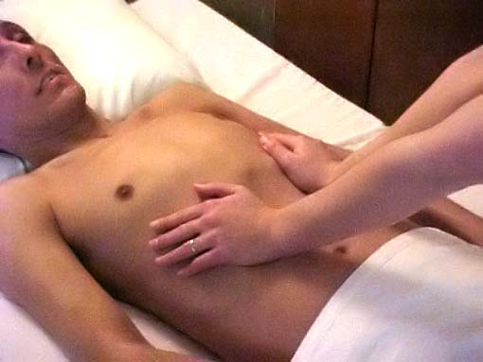
Assisted Cough In The Bed 2
Spread your hands around lower rib cage and upper abdomen.
With your elbows extended push inwards and upwards with both arms as client attempts to cough.

Slide 34
Assisted Cough In The Bed 3
Place forearm across upper abdomen of the client with other arm curved around the opposite side of the chest
As client attempts to cough push inwards and upwards with forearm whilst squeezing and stabilising with other hand.

Slide 35
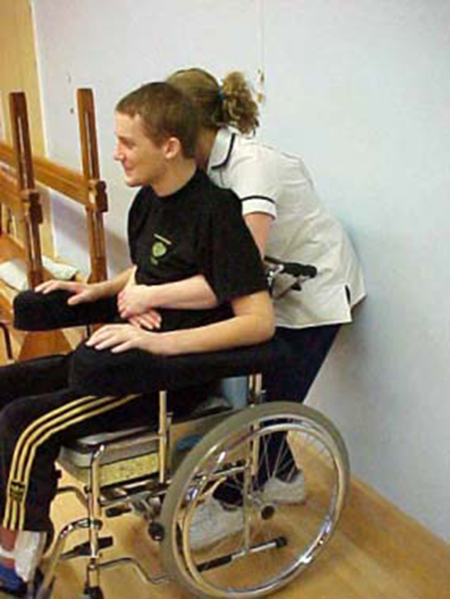
Assisted Cough In The Wheelchair
Lock brakes on chair
Stand behind the wheelchair and put your arms around the client linking your hands together in front over the lower ribcage and upper abdomen.
As client attempts to cough pull your hands up and inwards to assist.

Slide 36
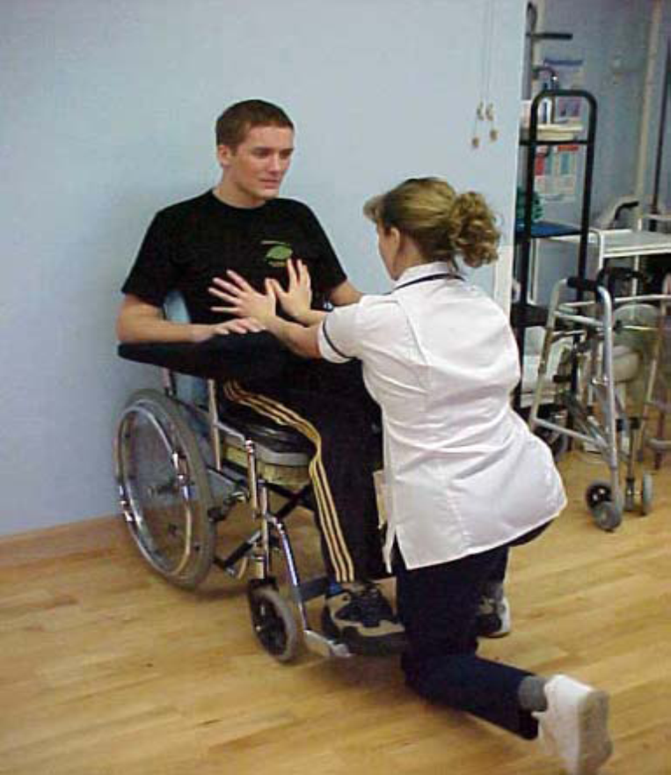
Back wheelchair up against wall so that it won’t tip backwards.
LOCK BRAKES.
Position yourself in front of client and place hands over lower ribs and upper abdomen. Push upwards and inwards as client attempts to cough.

Slide 37
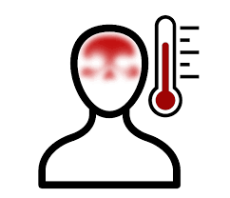
Body Temperature
Following cervical or thoracic SCI, the body’s normal ability to maintain its temperature within the normal limits is disrupted.
This is largely the result of the inability of the autonomic nervous system (ANS) to constrict and dilate the blood vessels.
Normally, when the body is too hot the ANS in response to instruction from the brain dilates the blood vessels, this brings them nearer to the surface of the skin causing the skin to become flushed and allowing heat loss, lowering the body temperature.
Conversely, if the body temperature is too cold, the message from the brain to the ANS results in constriction or narrowing of the blood vessels, which moves them away from the skin surface, the skin appears pale and the body gains heat.
The ability to lower body temperature by sweating is impaired.

Slide 38

Following SCI the ANS is unable to respond appropriately resulting in the person assuming the temperature of their surroundings.
It is important to be aware of the temperature of the environment and the clients body.
Wear warm clothes when going out into the cold, keep dry in the rain, remove layers of clothing that the client does not need.

Slide 39
Tips For Keeping Warm
Be prepared for weather changes when going outdoors
Ask your client to wear several layers of clothing rather than one thick layer.
Ask your client to wear a hat and gloves
Add layers when out in the cold, even for short trips.
Have warm drinks
If the client goes into a heated area i.e. shopping centre or a pub, remove the outer layer of clothing and put it back on when going outside again.

Slide 40
Tips For Keeping Cool
Wear a hat when in the sun
Sit in the shade when possible
Wear light coloured clothes in the sun, darker colours absorb heat
Avoid sunburn, when sitting the clients knees and feet will burn first, apply sunscreen and keep covered up when possible
Use a water spray (tepid water) on the clients face and neck to keep them cool in the sun
An electric fan is useful in the home
DO NOT transfer onto a chair cushion if it has been in the sun
Encourage your client to drink plenty of fluids

