Slide 1



Human Rights

Slide 2
Aims of the Session
To raise awareness of legislation that ensures that clients with spinal cord injuries are treated fairly and are not discriminated against.
Understand the importance of confidentiality.
Understanding the importance of ‘Person Centred Care’
What support you will receive from Spinal Homecare and your progression ?

Slide 3
The Human Rights Act
This 1998 Act brings the rights from the European Convention on Human Rights into UK law

Slide 4

European Convention on Human Rights (ECHR)
There is a Court of Human Rights in Strasbourg where people can go to claim their ‘rights’ under the convention.
Courts in the UK can also be used to uphold the ‘Human Rights’

Slide 5
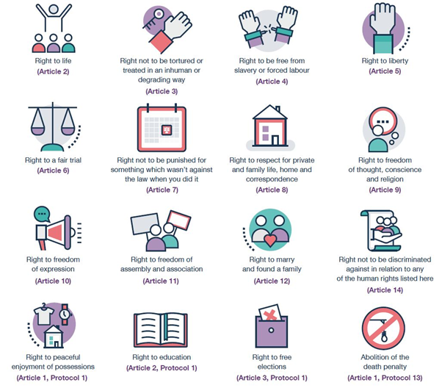
There are 16 rights in the Human Rights Act, each one is called an Article.
The right to life.
The right to freedom of torture and inhuman or degrading treatment or punishment.
The right to freedom from slavery, servitude and forced or compulsory labour.
The right to liberty and security of person.
The right to a fair and public trial within a reasonable time.
The right to freedom from retrospective criminal law and no punishment without law.
The right to respect for private and family life, home and correspondence.

Slide 6
8. The right to freedom of thought, conscience and religion.
9. The right to freedom of expression.
10. The right to freedom of assembly and association.
11. The right to marry and found a family.
12. The prohibition of discrimination in the enjoyment of convention rights.
13. The right to peaceful enjoyment of possessions and protection of property.
14. The right of access to an education.
15. The right of free elections.
16. The right not to be subjected to the death penalty.

Slide 7

The Commission wants to stop inequality, remove discrimination, strengthen good relations between people, and promote and protect human rights.
The Commission has also taken over the role of the Disability Rights Commission and will work to stop discrimination against disabled people.

Slide 8

Disability Discrimination Act 1995
(updated 2005)
The Disability Discrimination Act was implemented to address the discrimination faced by disabled people in the UK.
Disabilities is defined as a ‘physical or mental impairment, which has a substantial and long term effect on a persons ability to carry out normal day to day activities’

Slide 9

The Disability Discrimination Act 1995
(now part of the equality act 2010)
The Act is designed to prevent discrimination against people with disabilities in employment, access to education and transport, housing and obtaining goods and services.
Employers and landlords must not treat a disabled person less favourably than a non disabled person.
New transport facilities must meet the needs of disabled people and colleges, shops and other services must ensure that disabled people can use their services.

Slide 10
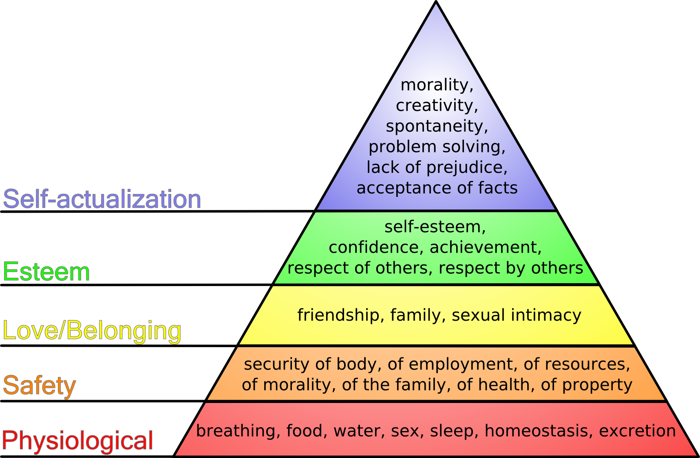
Maslow’s Hierarchy of needs

Slide 11

What is Person Centred Care ?

Slide 12
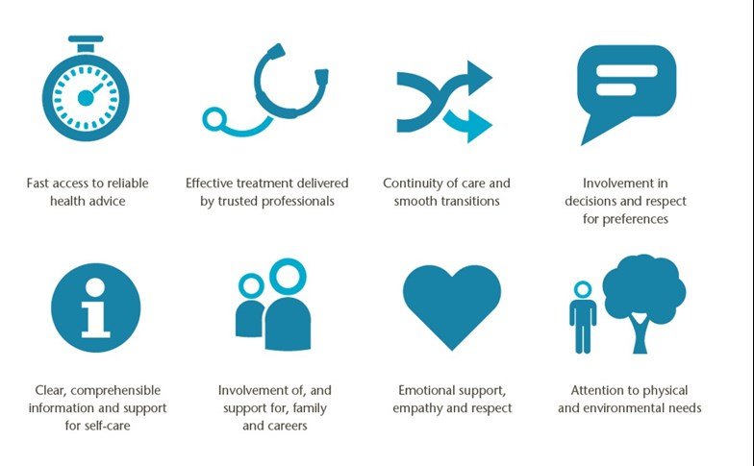

Slide 13


Slide 14

Under the Equality Act 2010 there are 9 protected characteristics

Slide 15

What to do if you feel you have been treated unfairly ?
Contact your Line manager and discuss , we are available 9am til 4.30pm (but many times outside of these hours)
If it is urgent please call the on call number provided to you at the end of this training document , this is very important .
If you are unhappy with your line managers response both Managing Directors are contactable at Spinal Homecare’s Head Office

Slide 16

Confidentiality
Duty of confidentiality
Clients have a right to expect that information about them will be held in confidence. This is central to the trust between them, their professional care team and their carer.
https://www.slam.nhs.uk/media/13524/carers-and-confidentiality.pdf

Slide 17


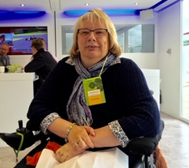

Lisa Wright – Regional
Care Manager (Midlands+ North)
Kirsty Sims – Regional
Care Manager (South East)
Michelle Howard – Regional
Care Manager (Swindon)
At Spinal Homecare we like to see our PA’s supported , after your online induction you will be given a mentor.
Your Mentor is there to support you into the role of PA
Staff Supervisions are every 3 months
Talk to us we don’t bite

Slide 18

What is a Supervision ?
Supervision is the regular, contact between a supervisor and a social care worker in which to monitor and reflect on practice; review and prioritise work with individuals; provide guidance and support and identify areas of work that need development.
What is an Appraisal ?
The purpose of appraisal is to develop and support staff so that they can perform at their best for the organisation. The appraisal meeting provides the opportunity to: review past and current performance. discuss performance strengths and areas for improvement.

Slide 19


