Slide 1


What Is a Spinal Cord Injury ?
Information obtained from :

Slide 2
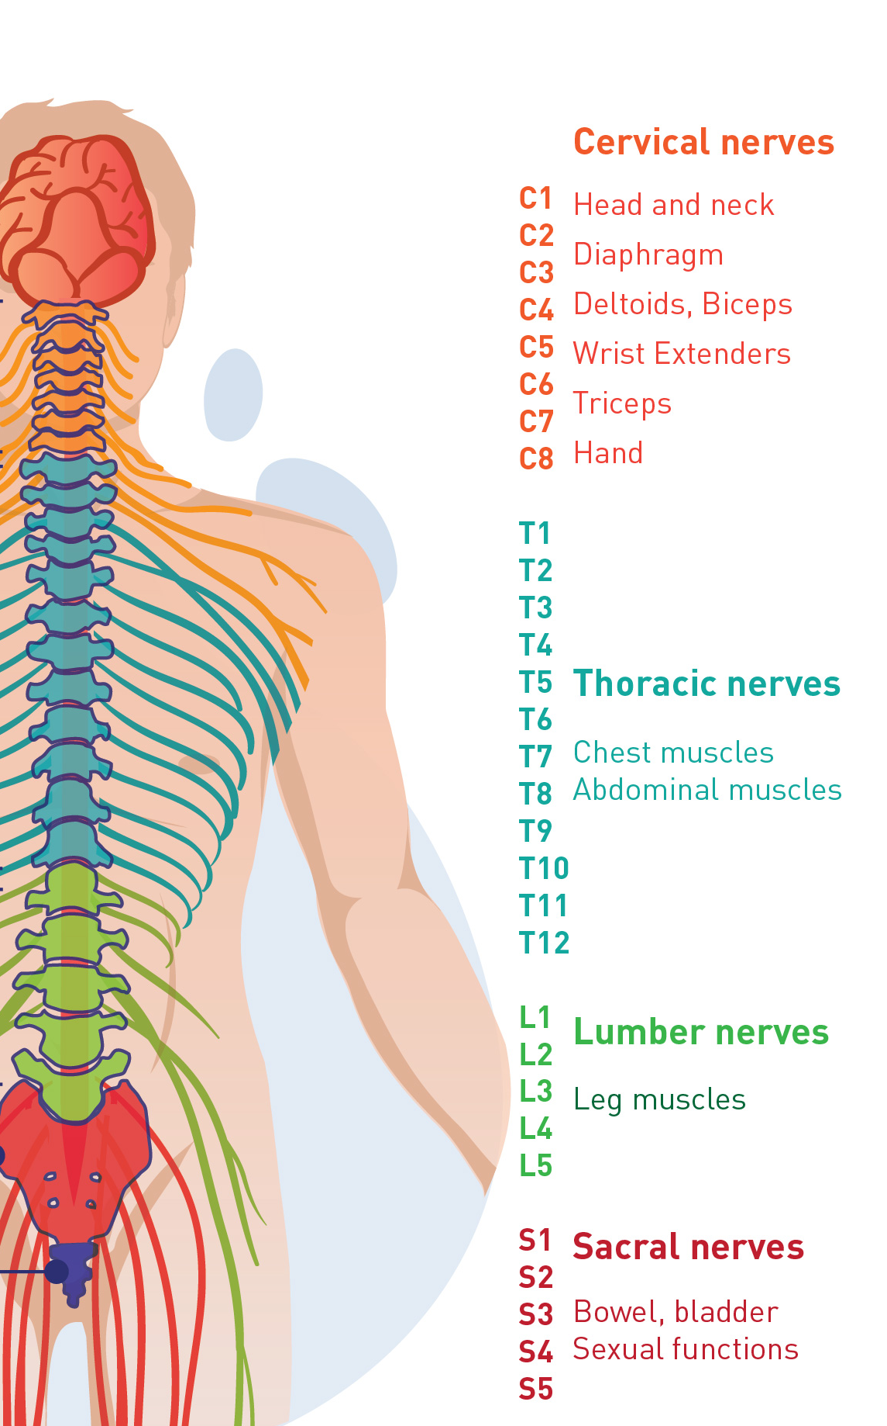
The spinal cord is an extension of the brain and is made up of a thick bundle of nerves.
The nerves carry messages from our brain to the rest of our body.
These messages help us to move our body, feel pressure and control vital functions like breathing, blood pressure, bladder and bowels.
When the spinal cord is damaged, the communication between our brain and the rest of our body is disrupted, resulting in a loss of movement and sensation from below the level of injury.
Damage to the spinal cord can be caused by a trauma like an accident, or as a result of infection or disease.

Slide 3
The History of Spinal Cord Injury’s in The UK
Rehabilitation as we know it today really began during the second world war when an escaping Germain Jewish Doctor Ludvig Guttman established the first spinal injuries centre at Stoke Mandeville in Aylesbury. He was a great believer in sports and activities being the key to getting people motivated after injury. His pioneering work formed the basis of how we treat a spinal cord injury, even today.
Originally when someone sustained an injury to their neck or back they would be placed in traction for up to 4 months at a time. Now days people are operated on shortly after they arrive at the hospital to stabilise the spin and get the person into a wheelchair ready to start rehabilitation. This cuts downs problems with pressure sores, bladder and bowel complications.
There are 10 spinal units in England and Wales but unfortunately not everybody with a spinal cord injury will be treated in one of those. A lot of injuries will be treated in major trauma centres up and down the country. Unfortunately those people won’t get the specialist rehabilitation that they need, which often leads to complications in the future.

Slide 4
The Prevalence of Spinal Cord Injury’s
There are an estimated 50,000 people in the UK living with a spinal cord injury and each year approximately 2,500 people are newly injured.
In the mid 80’s the average age of someone breaking their back or neck was 18-22 with 90% of those being male.
2018 the average age was 48-52 with the split being roughly 50/50 male/female, the biggest changes have been in the reduction of road traffic accidents.
What we now find is we are getting people aged 60-70 are sustaining injuries through falls. What that means is rehabilitation needs are very different.
With youngsters it is about getting them back to a level where they can tackle life to their full potential, the elderly basically want to return home to enjoy their later years.
Information obtained from :

Slide 5
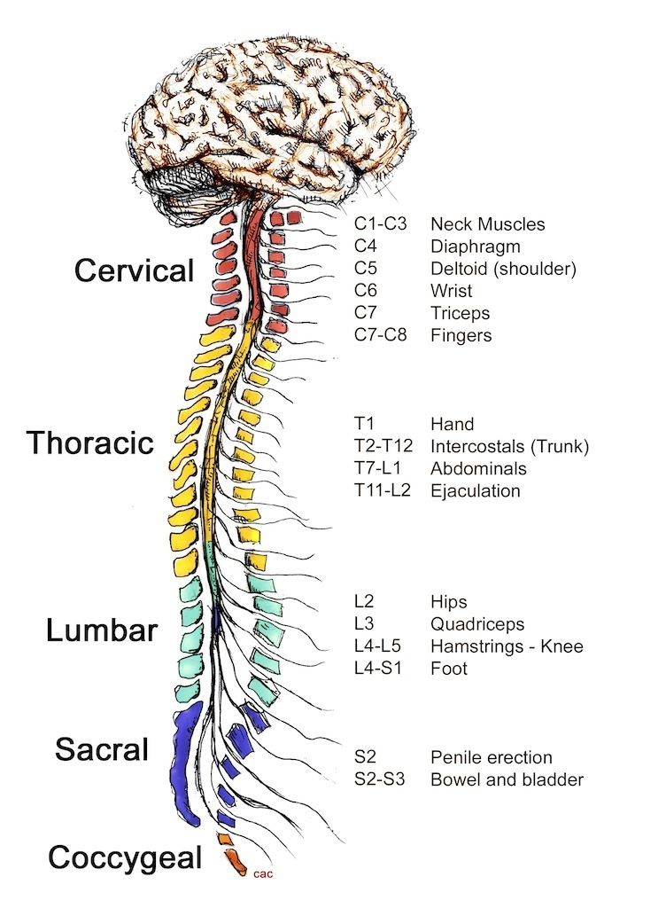
The Anatomy and Physiology of the Spine

Slide 6
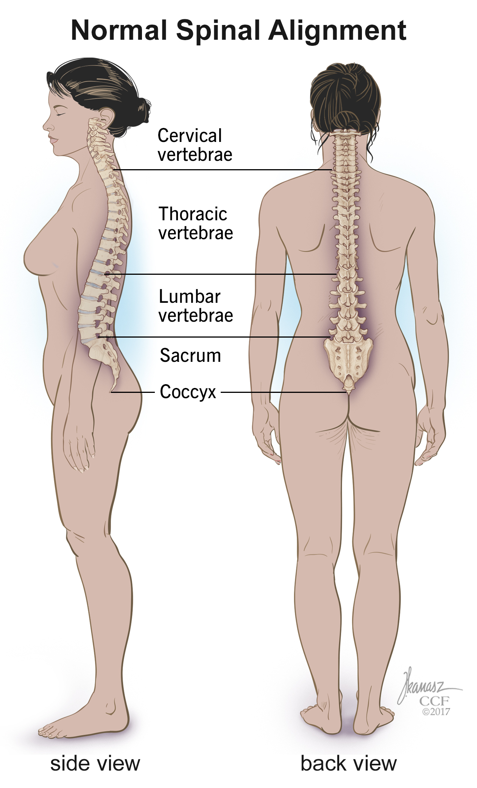
The spine is composed of 33 individual and fused vertebrae sharing certain common characteristics and grouped according to site and function.
There are: 7 cervical
12 thoracic
5 lumber
5 sacrum
4 coccyx
33 vertebrae.

Slide 7
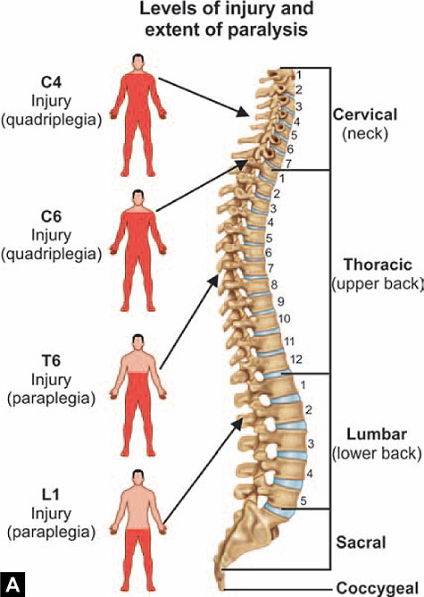

Slide 8
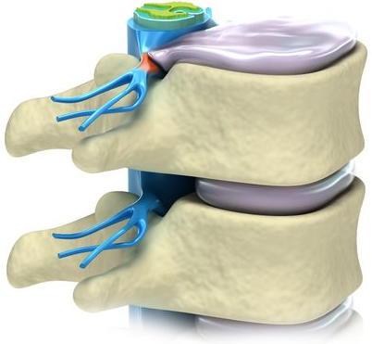
Complete vs. Incomplete
One of the terms you will hear often in reference to your spinal cord injury client is complete or incomplete.
A complete spinal cord injury causes a total loss of muscle movement and sensation at the injured site and below, because the spinal cord is totally damaged or severed at the site of injury.
A person with an incomplete spinal cord injury retains some level of function below the level of the injury, because the spinal cord is somewhat intact at the site of injury.

Slide 9

It is important to be aware that the loss of movement and sensation will vary from client to client, even with those who have damaged their spinal cord in the same place
EVERY client is an individual & abilities change

Slide 10



