Slide 1


Welcome to Spinal Homecare Online Induction Training
Your Trainers will be :
Lisa Wright
Michelle Howard
Emma Stewart

Slide 2

Lets meet you
Name & About You ?
If you could be any animal, what would you be and why?
If you could have any celebrity over for dinner, who would it be and why?

Slide 3

The course will run over 2 days
Day 3 will be with your mentor face to face over zoom
Please be prompt online at 9.30am
Virtual learning etiquette the do's and don'ts of online training
Please stop us and ask questions as often as you like or make a note and ask at the end of the session. No question is a silly question !
Do mute your microphone to avoid interference
Be respectful to each other
Try not to get distracted
Please do not share confidential information

Slide 4

Spinal Homecare are a specialist agency providing support needed for people to lead an independent life, whatever the level of disability.

Slide 5
“Your Life, Your Way”

Slide 6
The Company was established in 2002 and has two Company Directors who have considerable experience in the Care Sector and especially Spinal Cord Injury. In addition to providing a national (UK) live in service, we have also established a domiciliary day care service in the Lune Valley area.

Slide 7
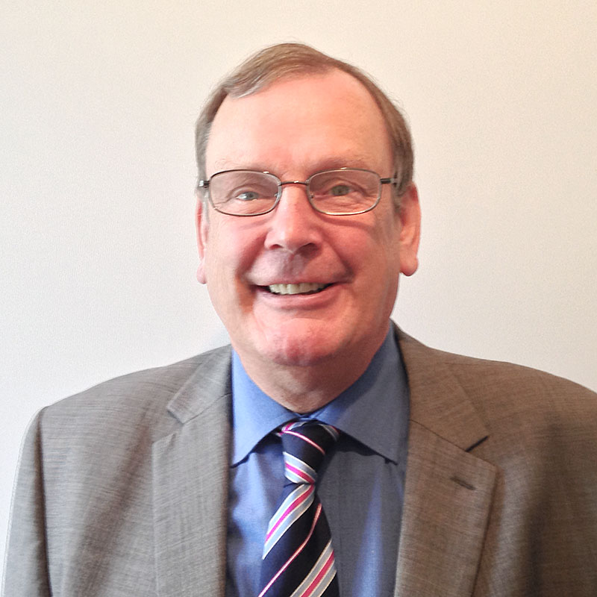
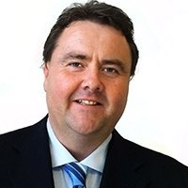
Directors
Tony Lyons
Managing Director
(Finance)
Andy Swanson (RGN)
Nursing Specialist in SCI.

Slide 8

Kirsty Sims
Kirsty is a Regional Care Manager. (Kirsty is based in London)
Lisa Wright
Lisa is a Regional Care Manager. (Lisa is based in Cheshire)
Michelle Howard
Michelle is a Regional Care Manager. (Michelle is based in Cheshire)
Emma Stewart
Emma is the Accounts Assistant and Trainer.
Laura Hunter
Laura is the Accounts Assistant and can be contacted in relation to wages and expense claims.
Glyn Rose
Glyn conducts interviews.
Andrew Swanson
Andy is currently arranging the placements while a new Care Manager is employed.
Jane Wilkinson
Jane prepares all the placement contracts.
Laura Hunter
Laura is the Accounts Assistant and can be contacted in relation to wages and expense claims.

Slide 9

Spinal Homecare offices
157 Stricklandgate,
Kendal,
Cumbria,
LA9 4RF
Clients
Supporting 40+ clients in their own home, these are both permanent and respite situations.
Staff
We have a ‘Team’ of up to 80 personal assistants working across the UK.

Slide 10



‘ISO’ and ‘CQC’ Information
ISO’ (International Organisation for Standardisation)
The ISO is a non-governmental organisation that is based in Geneva. The organisation is a world developer in standards, and co-ordinates the system.
The ‘ISO’ is a voluntary standard and there is no legal authority to enforce the implementation.
Spinal Home Care voluntarily conform to the ISO 9001:2000 which is concerned with ‘quality management’ systems; this includes training and development, complaints procedures and risk management.
The ISO standard is seen as a sign of quality and provides assurance to both clients and staff who use the service and also registration authorities (CSCI).
Spinal Home Care is inspected twice yearly to ensure that we conform to the standards; if standards are not achieved then they will revisit to confirm compliance.
www.iso.org
Commission for Social Care Inspection (CSCI)
Following the ‘Care Standards Act 2000’ the ‘National Minimum Care Standards’ were introduced, these provided all domiciliary care providers with a detailed set of standards that they are required to meet. The ‘Domiciliary Care National Minimum Standards’ consist of 27 specific standards (available on www.csci.org.uk or telephone enquiry line: 0845 015 0120).
Following the Health and Social Care (Community Health Standards 2003) the Commission for Social Care Inspection was launched in April 2004 as the single Inspectorate for all social care services in England.
Care Quality Commission
From 1st April 2009 the Care Quality Commission was introduced (CSCI no longer exists) and they will continue to register, monitor and inspect all health and adult social care in England. For more information: www.cqc.org.uk
The Regulation of Care (Scotland) Act 2001
Scottish Ministers have developed and published their own National Care Standards for a range of services being provided in Scotland; they have 23 sets of standards including the’ National Care Standards for Support Services’.
The Care Commission is responsible for registering and inspecting the services listed in the Act.
Within the ‘National Care Standards for Support Services’ there are 17 standards to be met. For more info and to download the Standards: www.scotland.gov.uk

Slide 11

Skills for Care provides practical tools and support to help adult social care organisations in England recruit, develop and lead their workforce.
They became the home of the National Skills Academy for Social Care in 2014.
By working with organisations and sharing best practice, we help to raise quality and standards and make sure dignity and respect are at the heart of service delivery.

Slide 12
What is the Care Certificate?
The Care Certificate is an identified set of standards that health and social care workers adhere to in their daily working life.
Designed with the non-regulated workforce 1 in mind, the Care Certificate gives everyone the confidence that these workers have the same introductory skills, knowledge and behaviours to provide compassionate, safe and high quality care and support.
The Care Certificate:
Applies across health and social care;
Will equip workers with the fundamental skill they need to provide quality care; and
Gives a basis from which workers can further develop your knowledge and skills as their career progresses.

Slide 13
What are the standards? The 15 standards in the Care Certificate are:
Understand your role
Your personal development
Duty of care
Equality and diversity
Work in a person centred way
Communication
Privacy and dignity
Fluids and nutrition
9. Awareness of mental health, dementia and learning disability
10. Safeguarding adults
11. Safeguarding Children
12. Basic Life Support
13. Health and Safety
14. Handling information
15. Infection prevention and control
The Care Standards & Codes of conduct for your role can be found in the workbook you will complete with this training & on the Spinal Homecare Portal.

Slide 14
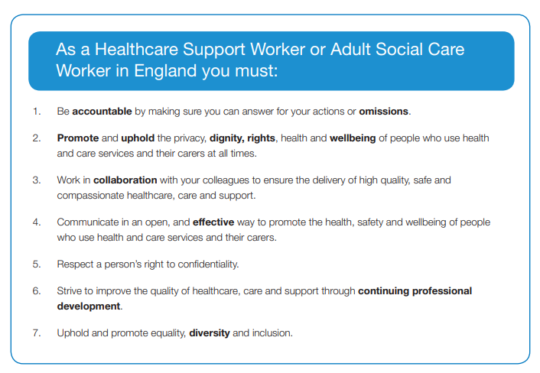

Slide 15

You have received your job offer and invite training from our Recruitment Manager Glyn Rose.
All the documents and forms requested by Glyn must be completed and returned asap including your Carer Profile.
One of the documents received is your job description, please ensure you read this and ask any questions on the training

Slide 16
Aims Of The Course
All newly recruited personal assistants are required to attend this ‘Induction Course’ in order to develop their skills and knowledge, enabling them to provide comprehensive and appropriate assistance under direction from a client who has a spinal cord injury.

Slide 17
Course Programme
Day One
Morning session
Meet & Greet
What is a spinal cord injury ?
Human Rights/Person Centred Values
Safeguarding
Discrimination / Equality
Confidentiality, Staff Support/Mentor & Supervision
Day Two
Morning session
Bladder Management
Bowel Management
Skin & Pressure Sores
Signs of Infection / Infection Control
COVID-19 / Vaccination / Weekly testing
Afternoon Session
First Aid
Reporting & Recording (paperwork)
Medication admin
Mar Charts & Exercise
Q&A
Afternoon Session
Fire Safety COSHH & RIDDOR
Nutrition & Food Safety
Moving & Handling
Wheelchair Safety
Bed Bath
Blue Light card / Penguin Bloom / SIA / Website Login
Q&A

Slide 18
Assessment
Our PA’s must have experience in a range of key practical skills and have performed in an acceptable manner throughout the course in order to successfully complete the course.
Candidates will also be required to demonstrate their underpinning theoretical knowledge by completing written questions/exercises

Slide 19

Facebook
If you haven’t done so already can we ask that you Like, Follow and Share our Facebook page.
There you will find regular updates on topics ranging from safeguarding our clients and staff in the fight against Covid-19 to job vacancies.
- https://www.facebook.com/SpinalHomecareServicesLtd/

Slide 20


£100 paid for every friend you recommend.
*Must both be employed by Spinal Homecare for a minimum period of 3months.
Application Form :
www.spinalhomecare.co.uk/job-application/

