Slide 1

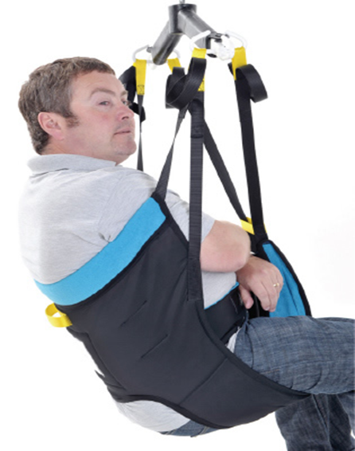
Moving and Handling

Slide 2
Aims of the session
We will consider the law & legislation in relation to moving and handling.
The Anatomy of the spine
We will explore moving and handling equipment & aids
Look at safe moving and handling techniques good & bad !

Slide 3
Workplace Regulations
-Health and Safety at Work Act 1974
-Manual Handling Operations Regulations 1992 (amended 2002)
-Lifting Operations and Lifting Equipment Regulations 1998
-Spinal Homecare Policies and Procedures

Slide 4

Health and Safety at Work Act (1974)
Employers/Us Must:
Provide a safe workplace
Ensure safe access to and from workplace
Provide information on health and safety
Provide health and safety training
Undertake risk assessment for all hazards
Employees/You Must:
Take reasonable care for their own safety and that of others.
Co-operate with the employer in respect of health and safety matters
Not intentionally damage any health and safety equipment or materials provided by employer

Slide 5

Manual Handling Operations Regulations 1992
(Amended 2002)
Employer/Us Duties
Employers must avoid all hazardous manual handling activity where it is reasonably practicable to do so.
Avoid
Assess
Reduce
Use mechanical equipment and an ergonomic approach
Employee/You Must
Co-operate in assessments
Follow safe systems
Use equipment provided
Report defects & unsafe practice
Participate in training

Slide 6

Lifting Operations and Lifting Equipment Regulations(LOLER) 1998
L.O.L.E.R covers risk to health and safety from lifting equipment
provided for use at work.
L.O.L.E.R requires that equipment is:
Strong and stable enough for the intended load
Marked to indicate safe working load
Used safely, the equipment's use should be organised, planned and
executed by competent people, Subject to ongoing examination and inspection by competent people.
ALL Hoists, slings and bath hoists are covered by the regulations.
LOLER states that lifting equipment must be examined by a competent
person every six months.

Slide 7
Spinal Homecare Moving and Handling Policy
OUR POLICY
-Any moving and handling will only be undertaken following approved training.
-All staff will receive annual training update on moving and handling and the use of equipment.
-All moving and handling equipment in a client’s home will be subject to risk assessments by a Manager prior to initial use and at the six monthly service review.
-Any equipment found unsuitable will not be used and reported in writing to the supplying agency using DOC 063 Reporting of Unsuitable Equipment.
-This policy should be used in conjunction with Spinal Homecare’s Health and Safety Policy (POL015) .
This policy can be found on our website please read it.

Slide 8

Spinal Homecare take seriously our responsibility in fulfilling our legal obligations and also in ensuring that our staff and clients do not sustain any injury as a result of any manual handling activity.
https://www.hse.gov.uk/statistics/overall/hssh1819.pdf

Slide 9


498,000
Workers suffering
from work-related musculoskeletal disorders (new or long- standing) in 2018/19
138,000
Workers suffering from a
new case of work-related
musculoskeletal disorder
in 2018/19
6.9 million
Working days lost
due to work-related
musculoskeletal
disorders in 2018/19

Slide 10
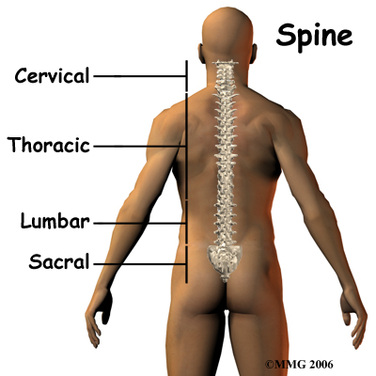
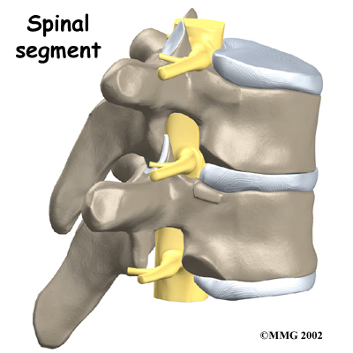
Maintaining a healthy back is important, it allows you to get the most out of life!
Walking
Standing
Bending
Work
Play
Sleep
Sitting
lifting

Slide 11
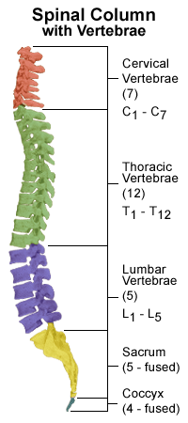
The Spine has 33 bones (vertebrae)
The upper 24 are separated by discs that act as cushions, they are linked by 118 joints.
The spinal cord is a 1/2inch thick cable of nerves about 45cm long.
There are 31 pairs of nerves branching out from spinal cord, these send information between the brain and other parts of the body.
There are about 400 muscles, producing motion in all directions.

Slide 12
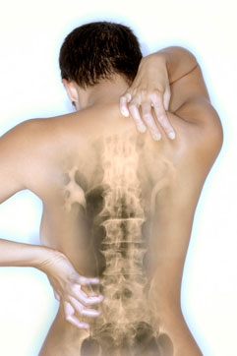
A lot can go wrong!!
A strain or fatigue will affect your spine and muscles in the upper body or lower back.
Injury or disease such as an infection or arthritis, can weaken the back, Strain, fractures or a ruptured disc can result in a ruptured or ‘slipped’ disc, This can press on the spinal nerve, and cause pain in the lower back and legs.
A fractured vertebrae may injure the spinal cord.

Slide 13

Look after yourself!
-Get in shape!! A lot of back ache is due to lack of exercise, resulting in weak abdominal and back muscles.
-Watch your weight! Carrying extra weight puts extra strain on the spine.
-Improve your posture.
-Follow safe moving and handling techniques and use equipment provided.

Slide 14
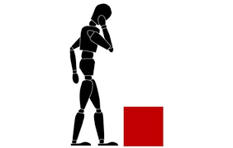
Inanimate Loads

Slide 15

Lets have a think about what inanimate loads you handle on
a day to day basis ?
What do you move/lift?
How often?
Where?
Why?
*Assess the risk that each item represents.

Slide 16
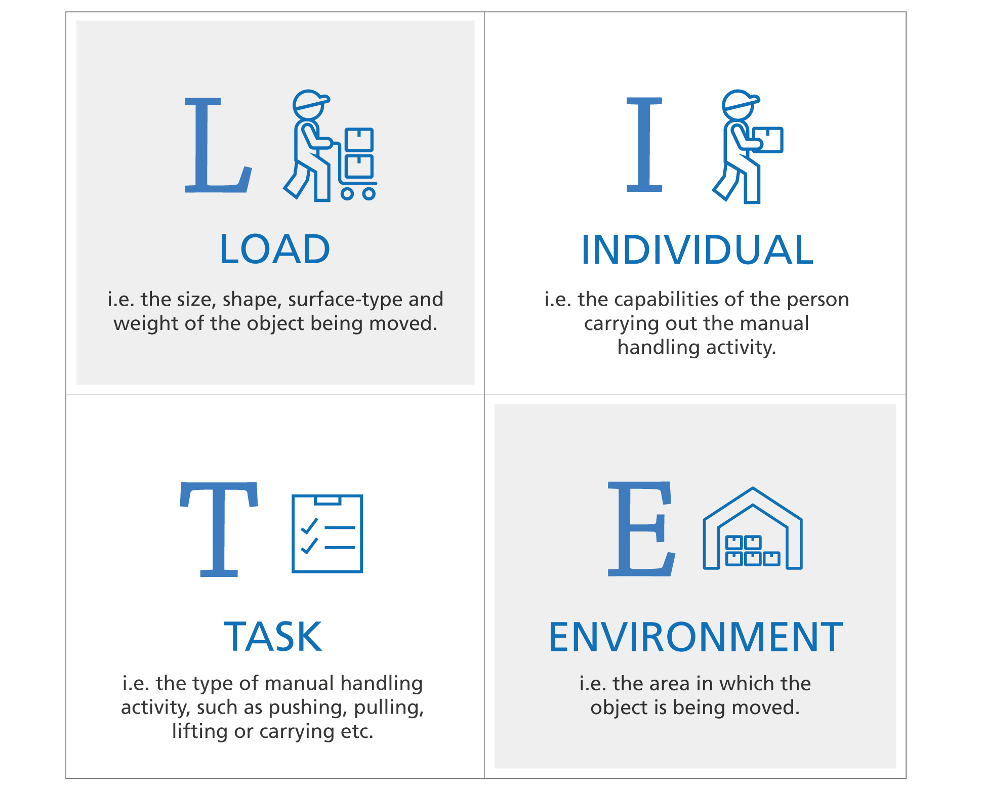
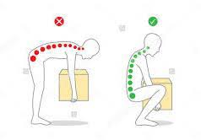

Slide 17


The principles of safe handling apply to inanimate loads.
STOP DO NOT LIFT
ASSESS FIRST
-Task
-Individual
-Load
-Environment & Equipment

Slide 18

Keep spine in its natural curve
Don’t twist
Keep your feet in the direction that you are going in.
Keep within your base to be in balance.
Use leg muscles
Keep the load close to the body

Slide 19
Moving People!
An important part of the role of the Personal Assistant is to assist in the safe moving and handling of your client.
All Clients have a comprehensive
‘Needs and Risk Assessment’
This is available in the clients home in their care plan folder
READ IT And FOLLOW IT

Slide 20
EQUIPMENT YOU WILL USE
-Each client will use a range of aids these will assist you
and the client in moving and handling them safely .
-Familiarise yourself with them at handover
-Participate in the handover as much you can
-This WILL give you confidence when handover is complete and you are alone

Slide 21
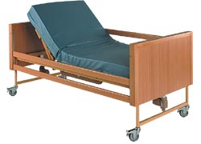

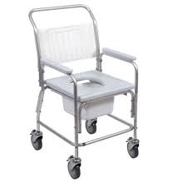
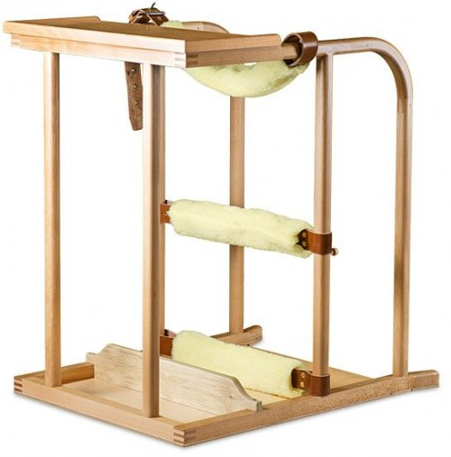
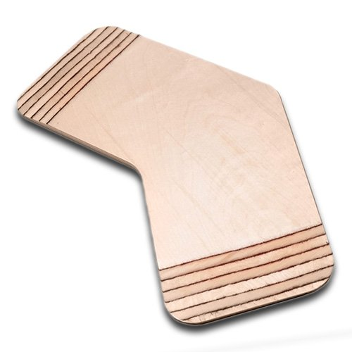

Slide 22
Slide Boards
A short video will follow showing how effective they are when moving & handling clients
https://youtu.be/36x1xBmHJJA

Slide 23
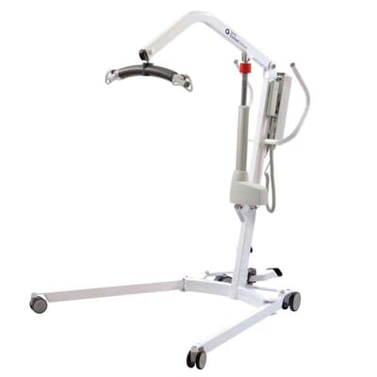
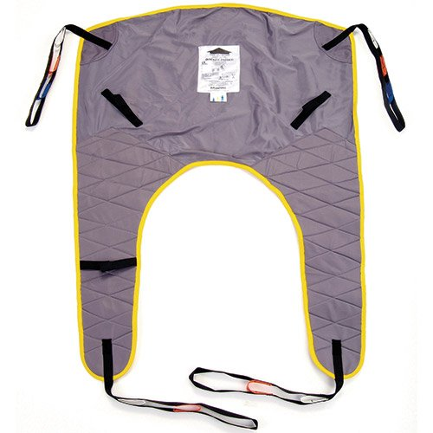
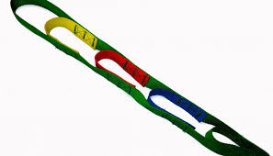

Slide 24

Hoist & Sling
A short video demonstration will follow showing how to use a typical sling and hoist when moving & handling clients
https://youtu.be/yjSpyldImeI

Slide 25
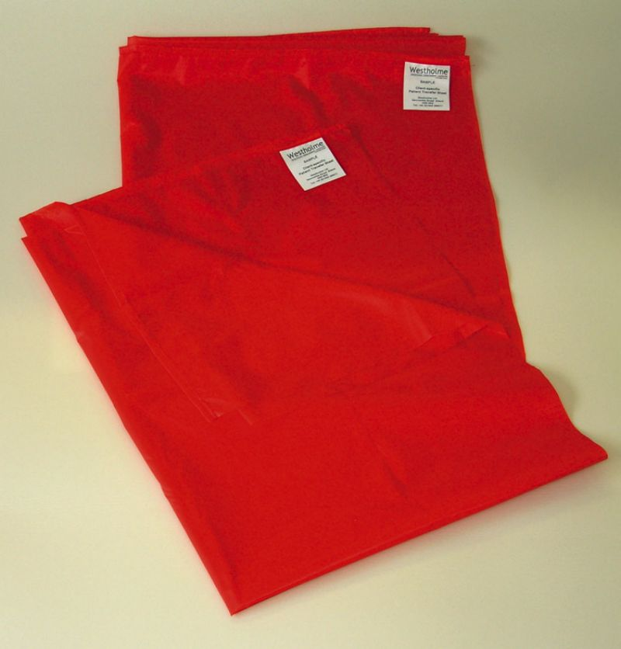
Slide Sheet
A short video will follow showing how effective slide sheets are when moving & handling clients
https://www.youtube.com/watch?v=pbmC27Z3kuc

Slide 26
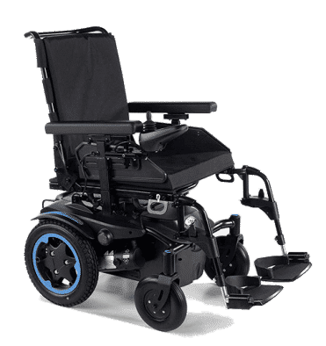
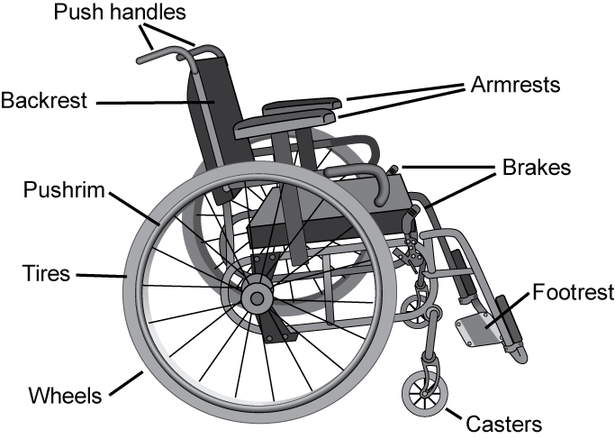
Wheelchairs

Slide 27
Always inform the person of your intentions.
Plan for the safest route to your destination where sloped curbs, ramps and flat surfaces are available.
Avoid pushing a wheelchair when conditions such as rain, snow or long grass cause pushing to become strenuous.
Use both hands when pushing a wheelchair.
Ensure bags on the back rest do not interfere with your proper body posture or the correct balance of the chair.
Try to maintain a 90 degree angle for your wrists, arms and shoulders when pushing. If you’re unable to push the wheelchair safely, inform your client immediately.
Do not rush, use a sensible speed.
Before starting to push ensure the person’s feet are properly positioned on the foot rest, the seat belt is secure and the wheels are free of objects that may get stuck during the walk.
Use ramps or sloped sidewalks at all times.
Anti-tip bars shall remain in place at all times.
If stopping for any period of time brakes must be put in the locked position.
Watch for small lips or changes in flooring that may cause difficulties for pushing.

Slide 28


Bed Bath & Personal Care
Bed bathing is not as effective as showering or bathing and should only be undertaken when there is no alternative
(Dougherty and Lister, 2015).
If a bed bath is required, it is important to offer patients the opportunity to participate in their own care, which helps to maintain their independence, self-esteem and dignity.

Slide 29
General principles of bed bathing
Dispose of used linen immediately
Keep your client warm at all times
Only expose the area of the body being washed at the time
Change water if it becomes dirty or cold and always after washing the genitalia and sacrum
Change wash cloths if they become soiled and after washing the genitalia and sacral area
Check skin for pressure damage
Avoid contaminating dressings and drains with water
Pat the skin dry to reduce the risk of friction damage
Separate skin folds, and wash and pat them dry
Use the correct manual handling procedures and equipment to avoid injury to yourself and the patient
Remember to talk, communicate with them through what you are doing

Slide 30

Get ready for the bath
Ask the person if the room is too warm or too cool, and change the temperature if needed.
Make sure that the bed is high enough so that you don't hurt your back. If it is low, it is okay to put your knee on the bed to reach over and bathe the person.
Place a waterproof mat or sheet under the person to keep the bed dry.
For privacy, make sure the door is shut and the blinds or drapes are closed.
Some things to remember
After you or your client washes an area, turn the washcloth so you can use a new, clean part of it for the next area.
Use a new washcloth when you need one.
As you help your client wash, check the skin for redness or sores.
Pay special attention to areas with creases such as beneath the breasts or the folds on the stomach.
Also look at the groin area and bony areas, such as the elbows and shoulders.
Also look at heals and between toes Always make sure they are dried properly

Slide 31



To give a bed bath, you may need:
Clean bed linen and clothes
Two bath towels
Four or more washcloths or bath sponges.
Two wash basins (one for soapy water, one for rinsing)
Creams if prescribed
Clients toiletries
Comb/brush
Equipment for oral and denture care (if Needed)
Wash bowls
Non-sterile gloves if personal protective equipment is required or for intimate care
Catheter Leg Bag /Straps

Slide 32
That concludes Spinal Homecare Online Moving & Handling Induction Training .
Remember your handover is important , this is your chance to see how things are done with your client

Slide 33



