Slide 1



Slide 2
Covid-19
Main symptoms
The main symptoms of coronavirus are:
a high temperature – this means you feel hot to touch on your chest or back (you do not need to measure your temperature)
a new, continuous cough – this means coughing a lot for more than an hour, or 3 or more coughing episodes in 24 hours (if you usually have a cough, it may be worse than usual)
a loss or change to your sense of smell or taste – this means you've noticed you cannot smell or taste anything, or things smell or taste different to normal
Most people with coronavirus have at least 1 of these symptoms.

Slide 3
What to do if you have symptoms
If you have any of the main symptoms of coronavirus:
Call the office to organize a test for coronavirus as soon as possible.
2.You and your client should stay at home and not have visitors until you get your test result – only leave to have a test.
Anyone in your support bubble should also stay at home if you have been in close contact with them since your symptoms started or during the 48 hours before they started.

Slide 4
What is PPE?
PPE is designed to protect you from harmful substances such as chemicals or infectious agents.
In a pandemic situation, it can also help prevent the transmission of infection between PA and Client.
The type of PPE you need will depend on the environment you work in and the procedures you carry out.
Remember: PPE is just one way of protecting staff at work. Handwashing, workplace cleaning practices and risk assessments also play an important role in infection prevention and control.

Slide 5
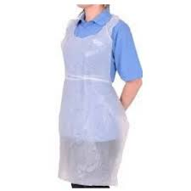
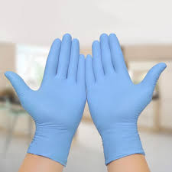
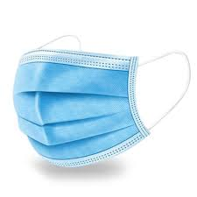
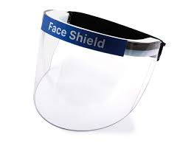

Slide 6
Apron
Gloves
Fluid repellent surgical mask
Eye protection, Either a visor or goggles, can be used (prescription glasses are not eye protection), subject to risk assessment such as if the person has a cough

Slide 7
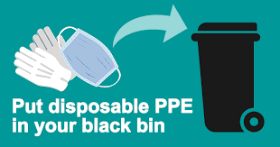
Removal of PPE:
All protective items used are a one time use .
All PPE needs to be disposed of correctly after interaction .
Fresh PPE should be used when dealing with clients.
We recommend that adequate PPE be used when arriving with a new client for the first 5-7 days. Were social distancing cant be met.

Slide 8
Why is Hand washing So Important?
The importance of hand washing cannot be understated. Hands are the primary carriers of dirt, viruses, and bacteria, as they can come into contact with so many different surfaces throughout the day. Without proper hand washing, this could easily lead to something harmful entering the body, spreading elsewhere, or causing cross-contamination.
The following hand washing facts show just how easily hands can spread bacteria:
Globally, only one in five people wash their hands after using the bathroom.
The average office worker’s hands come into contact with 10 million bacteria per day.
An estimated 61% of healthcare professionals do not clean their hands correctly.
Around 50% of hospital-acquired infections can be easily avoided through better hand hygiene.
Contaminated hands can transfer viruses to more than 5 surfaces or 14 other objects.
Damp hands spread 1,000 times more bacteria than dry hands.
Bacteria can stay alive on hands for up to 3 hours.

Slide 9
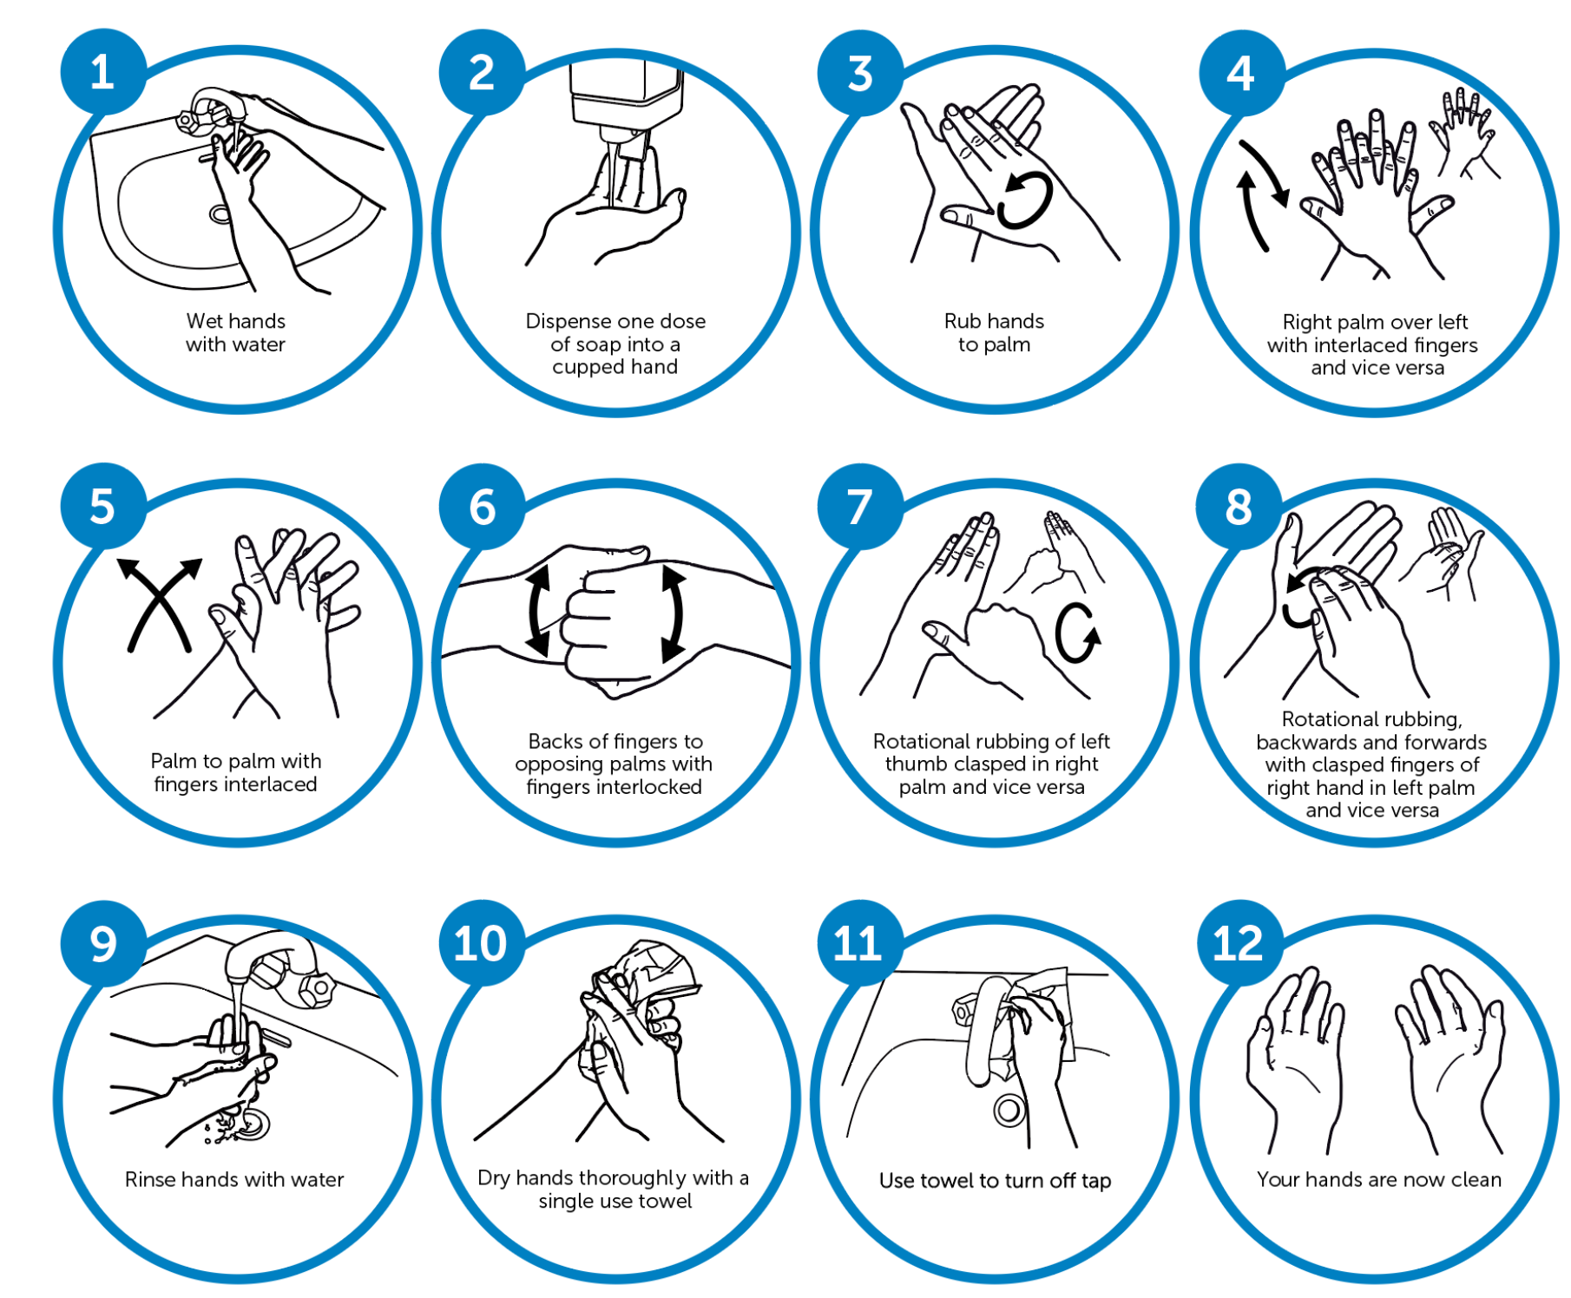


Slide 10

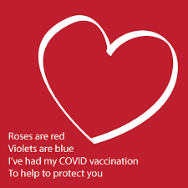
Get Your COVID-19 Vaccine
You can book your vaccination appointments online if any of the following apply:
you are aged 65 or over
you have previously received a letter saying you are at high risk from coronavirus (clinically extremely vulnerable)
you are an eligible frontline health worker
you are an eligible frontline social care worker
You can book appointments at a larger vaccination centre or a pharmacy that provides COVID-19 vaccinations.
You do not need to wait to be contacted by the NHS.
https://www.nhs.uk/conditions/coronavirus-covid-19/coronavirus-vaccination/book-coronavirus-vaccination/

Slide 11
