Slide 1

Aims Of The Session:
Identify how infection can be spread and how to reduce the risk of cross infection.
Carer to be able to recognise signs of an infection.
Carer will be able to use a thermometer to take and record and temperature.
Carer to know the normal pulse and respiratory rates, and
how these can be measured.
Carer to be aware of good practice in relation to food
handling, preparation and providing a nutritious, balanced
diet.

Slide 2
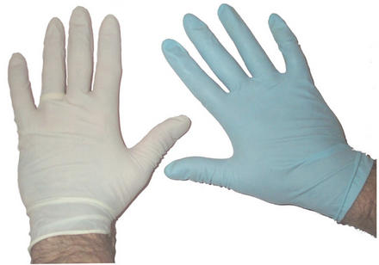
Standard Infection Control Precautions
Hand Hygiene
Personal Protective Equipment
Safe use and disposal of sharps.
Safe handling and disposal of waste.
Safe management of laundry.
Food Hygiene
Hand washing is the most important method of reducing the transfer of infection and forms the basis for universal precautions.

Slide 3
How To Wash Your Hands Effectively
Wet your hands thoroughly under warm running water and squirt liquid soap onto the palm of one hand.
Rub hands together to make a lather.
Rub the palm of one hand along the back of the other and along the fingers, then do the same with the other.
Rub in between each of the your fingers on both hands and around your thumbs.
Rinse off the soap with clean running water.
Dry hands thoroughly on a clean dry towel.

Slide 4
Routes of Infection
Direct Contact
Hands
Kissing
Intimate contact
Body fluids
Contaminated items
Inhalation
Sneezing
Coughing
Spitting
Toilet flushing
Ingestion
Hands
Food
Inoculation
Sharps Injuries
Bites
Scratches and wounds

Slide 5
Susceptible Host
Certain groups of people, including those who are old, very old or immunosuppressed are at increased risk of acquiring an infection because the body’s defence mechanisms may be weakened or underdeveloped.

Slide 6
Other Infection Risks
One of the key issues in controlling infection in any environment is the safe disposal of contaminated waste.
Including:
Gloves
Sharps and needles
Body fluids
Soiled dressings
Soiled linen

Slide 7
Signs Of An Infection?

Slide 8
Temperature
The normal range of body temperature for an adult in good health is between 35°c and 37°c.
‘Pyrexia’ is when someone has a raised temperature and can become unwell.
Select a thermometer and have a go at taking a temperature.

Slide 9
Pulse Rate
The normal range of the pulse of a healthy adult at rest is between 55-95 beats per minute, average being around 60-80bpm.
Respiratory Rate
The normal range of respiration for an adult at rest may vary between 12-20 breaths per minute, normally about 16.
Have a go at taking your own pulse, is it regular? How many beats per minute?

Slide 10
Safe Food Handling
Food poisoning is an illness caused by eating contaminated food. Food can be contaminated by:
Bacteria, viruses and moulds
Chemicals and metals
Poisonous plants, e.g berries, toadstools

Slide 11
Each year it is estimated that as many as 5.5 million people in the UK suffer from food poisoning.

Slide 12
Bacteria causes the majority of food poisoning cases.
Bacteria requires warmth, moisture, time and food to multiply. The optimum growth temperature for bacteria is between 5° and 63°c, this is known as the ‘danger zone’.
High Risk Foods
Cooked poultry
Cooked meats
Dairy produce
Shellfish and seafood
Cooked rice
Raw eggs in foods

Slide 13
Food Contamination Risks
People
Air
Raw foods
Animals
Insects
Refuse

Slide 14
In order to maintain our own health and that of our clients we need to eat a healthy diet.
We need to eat a healthy, balanced diet, that includes:
Carbohydrates
Fats
Proteins
Fibre
vitamins

Slide 15
Which Foods Would You Try To Limit?

Slide 16
Factors that may affect a persons ability to eat and drink in usual manner.

