Slide 1

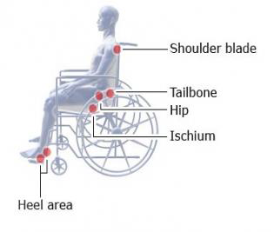
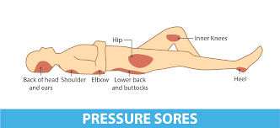
Skin Management & Pressure Sores

Slide 2
The Importance of Effective Skin Care in Spinal Cord Injury
After a spinal cord injury, there is a decrease in sensation and your blood circulation slows down. This means that your skin is not able to heal itself as well as it did before. Your skin will be unable to withstand pressure as much as before your injury. If your skin is put under pressure (for example, through tight clothing), and you can’t feel the pressure or discomfort this is causing, you don’t know to relieve it. When this happens, your skin is strained and the skin tissue will die, leaving an open wound; soon after, a pressure sore will appear on the damaged skin.

Slide 3
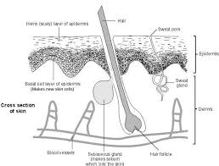
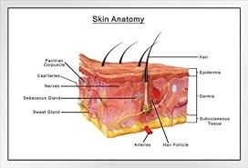
Your skin How does it work?
The skin does more than just cover up your body.
It is a complex, valuable organ of your body, and is made up of two main parts:
The epidermis, which is the smooth outer layer that you can see
The dermis, which is the thick, strong and elastic underneath layer.

Slide 4
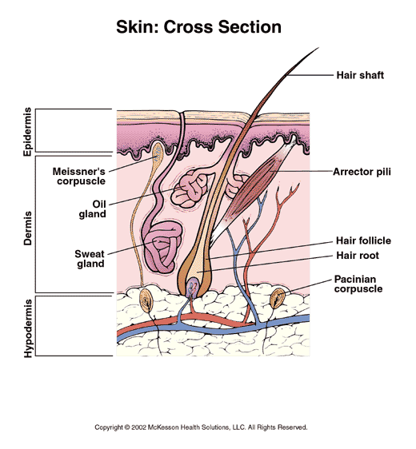
Anatomy of the Skin
Consists of 3 layers:
-Epidermis
-Dermis
-Hypodermis

Slide 5
Functions of the skin
The skin has several important jobs to do:
It protects your body against air, water, germs and most foreign substances;
It helps you feel pain, pressure, touch and temperature through its sensory receptors;
It gets rid of water, salts and oils when you sweat;
It helps regulate your body by absorbing heat and releasing it through sweating;
It heals itself by repairing minor wounds such as scratches and bruises.

Slide 6
What are pressure sores?
Pressure sores are sometimes called bedsores or decubitus ulcers.
They happen when your skin is put under pressure for long periods of time and your blood (which carries oxygen and nutrients around your body) can’t get to that area.

Slide 7
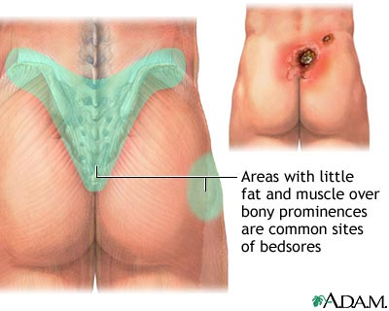

Slide 8
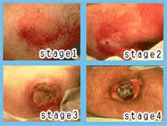
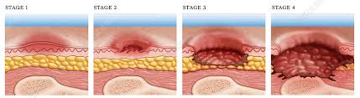
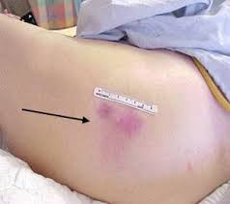
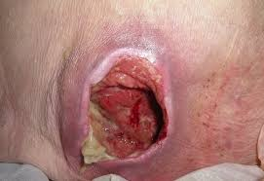
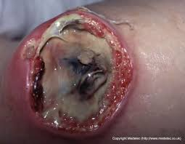
Bony areas of your body, such as the sitting bones in your bottom tend to be the first places your skin gets damaged. Because of your muscles wasting and lack of spasms, there is less padding on your bony areas.
The bones pressing against your skin puts pressure on it from the inside, and there may be pressure on your skin against its outer layer.
The blood supply between these two areas of pressure will be stopped.

Slide 9
Sitting or lying against hard surfaces
You can put pressure on your skin by sitting or against surfaces like:
safety pins
buttons and studs on jeans, trousers and skirts
thick, bulky seams
objects you’ve put in your pocket, like keys or coins
catheter connectors & Clamps
Friction/Shearing
‘Shearing’ happens when your skin is pulled sideways or in opposite directions, such as when you slip down the bed or if your buttocks are dragged rather than lifted when you’re transferring or being transferred onto your bed.
Clothes and equipment
Things digging into your skin can also put pressure on your skin, like:
tight clothing (especially over catheter tubing)
sanitary products
tight socks or shoes
worn out or ill-fitting equipment (like hoists).
Bad posture
Having bad posture (like slouching) when in a wheelchair or lying in bed puts pressure on your skin and makes you more prone to pressure sores.
Nutrition Weight gain or Loss

Slide 10
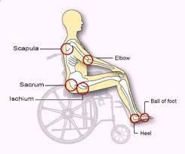
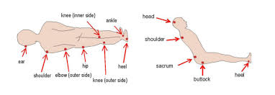
Were can we get a pressure sore?

Slide 11
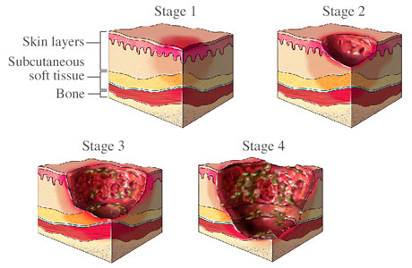
What are the stages
and signs of a pressure sore?

Slide 12
The Four Stages of Pressure Injuries
Stage 1 Pressure Injury: Non-blanchable erythema of intact skin.
Stage 2 Pressure Injury: Partial-thickness skin loss with exposed dermis.
Stage 3 Pressure Injury: Full-thickness skin loss.
Stage 4 Pressure Injury: Full-thickness skin and tissue loss.

Slide 13
What Is Not A Pressure Ulcer
Blanching Erythema
The reddened area turns white/pale when pressed with finger tips then colour returns
Should resolve when pressure is removed for significant time
Moisture Lesions
Wet skin caused by faeces, urine, wound exudate, sweat…
Excoriation, maceration

Slide 14
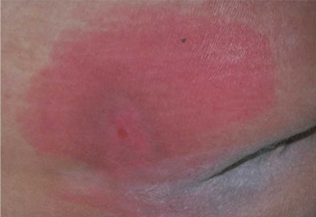
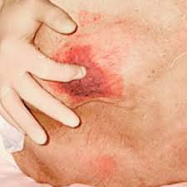
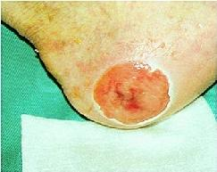
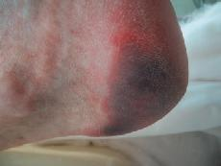
Pressure Ulcer Classification
Grade 1
Grade 2
Grade 3
Grade 4 (necrosis)

Slide 15




What do you do if a pressure sore develops ?
Examine it &
Tell your client
Call Office / Care Manager
Record it
*even if its existing
Follow up with a email

Slide 16
Next Steps
Relieve pressure asap
Increase & encourage turn times
Encourage client to stay off the area.
Contact the district nursing team.
Investigate cause

Slide 17
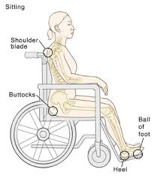
Skin Checking
When to check?
Use every opportunity to check your clients skin , this could be during bowel routine or showering
Who is responsible?
You & the client
What do you check when the patient is in their wheelchair?

Slide 18
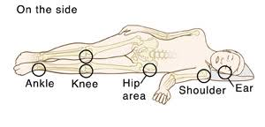
What do you check in bed?
What do you check in cars?
What do you check in the bathroom?

Slide 19
Main advice when dealing with pressure sores is to stay off the area until it is completely healed.

Slide 20


