Slide 1

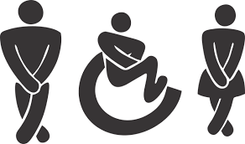
Bladder Management

Slide 2

What you need to know
A spinal cord injury (SCI) will limit your ability to control your urine.
Your client might not be able to stop urine from flowing, or release it.
Uncontrolled urination or inability to empty your bladder can have a negative effect on quality of life and cause bladder and kidney infections and other problems.
Appropriate bladder management will help keep the bladder and kidneys healthy.
Each type of bladder management option has pros and cons.
In this section we will see the different types.

Slide 3
Aims of Bladder Management
Maintain client ‘well being’ when there are medical conditions such as enlarged prostrate
Dignity and comfort for the client
Maintain skin condition
Monitor output

Slide 4
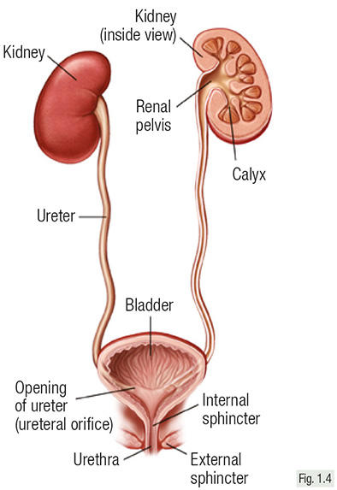
Urinary System
Kidneys filter the waste products.
The urine is then passed down the Urethra into the bladder.
The urine collects in the bladder, when full the sphincter is released and urine is passed via the Urethra.

Slide 5
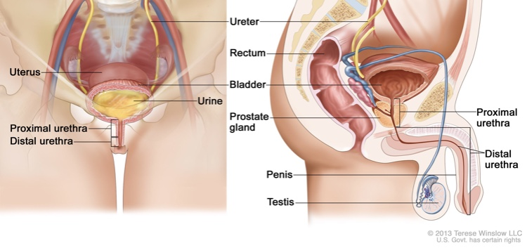

Slide 6
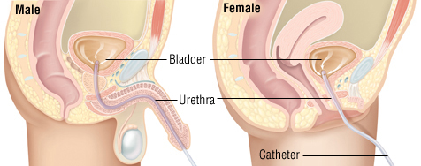
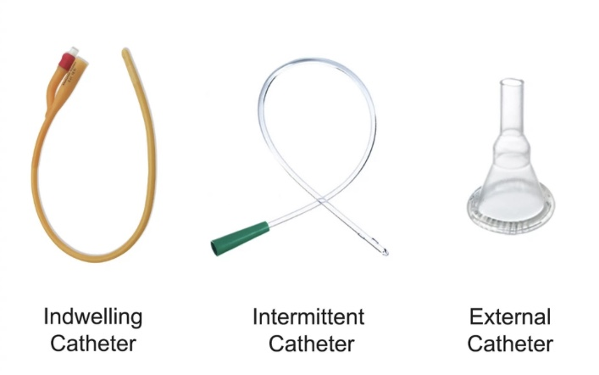
Methods of Bladder Management Urinary Catheter Types
Indwelling Urinary Catheter
Supra Pubic Catheter
Intermittent Catheter
Sheath

Slide 7
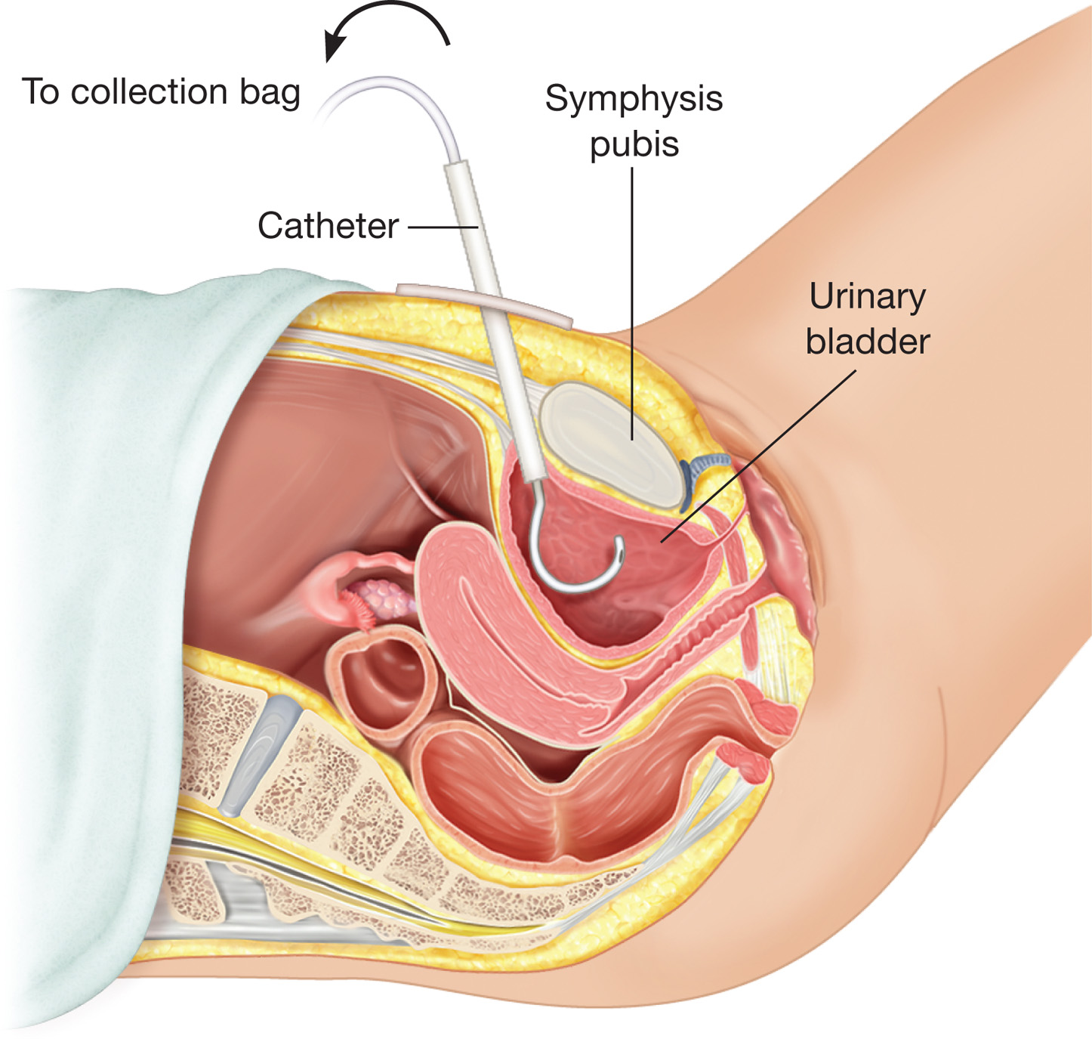
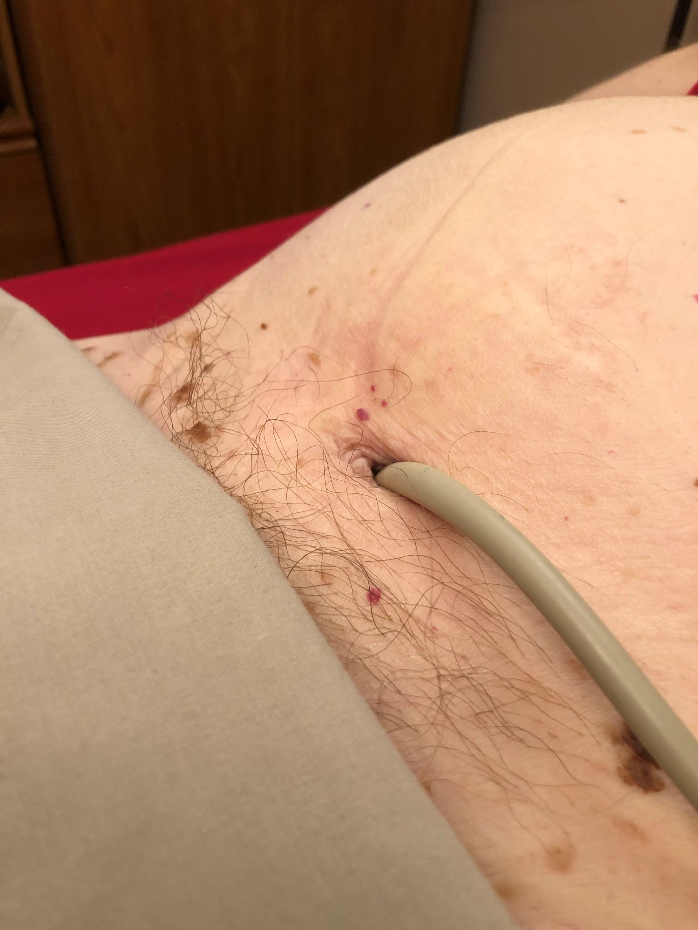
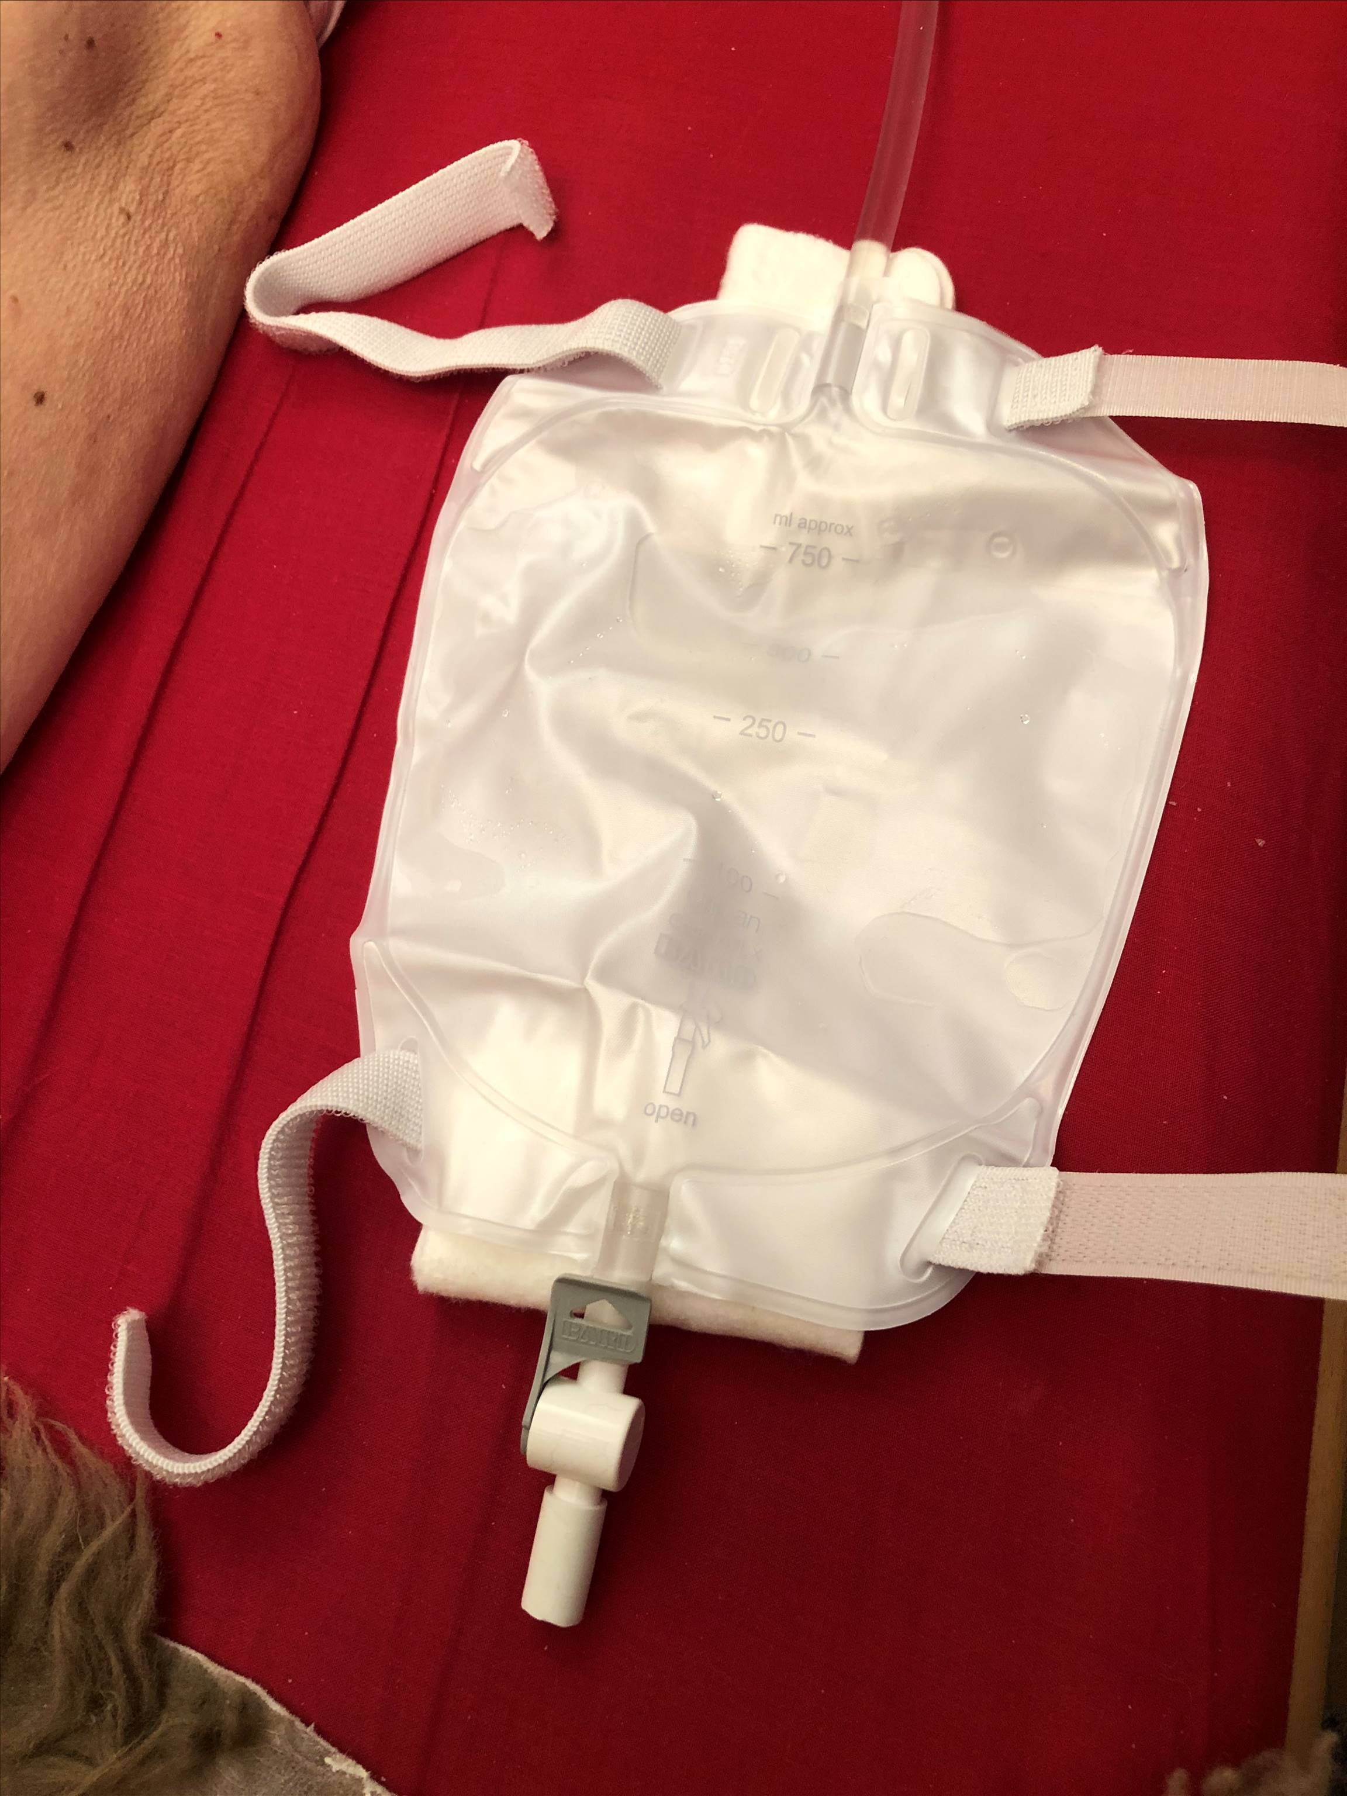
Suprapubic Catheter
Suprapubic Indwelling Catheter Site
Typical Leg Bag and Strap

Slide 8
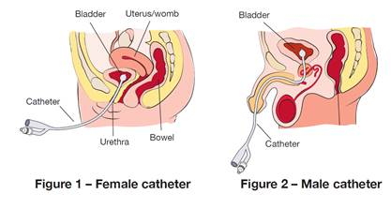
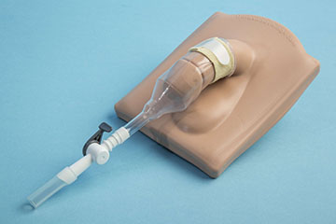
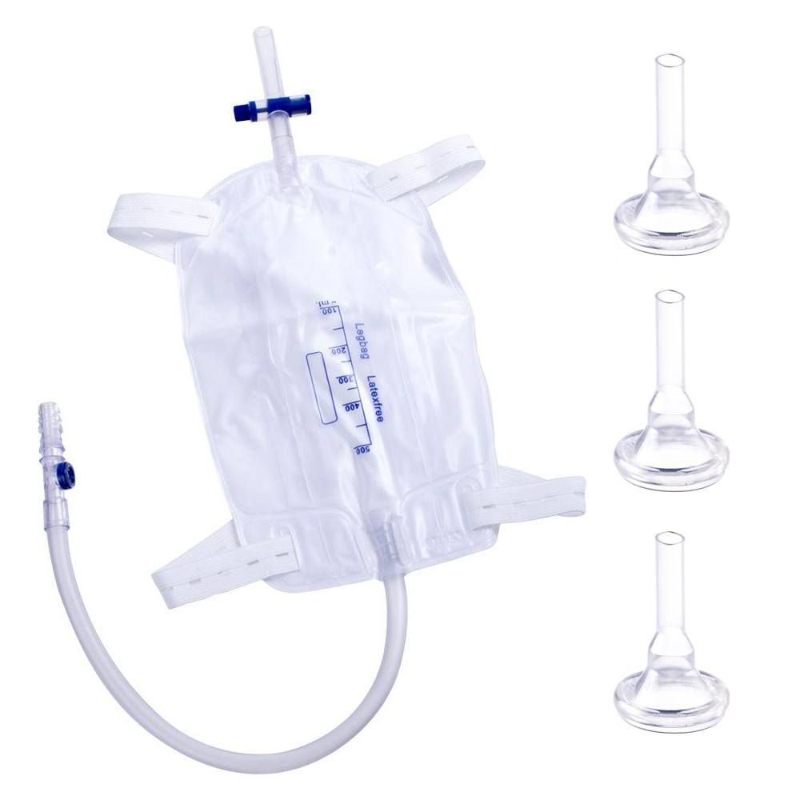

Slide 9
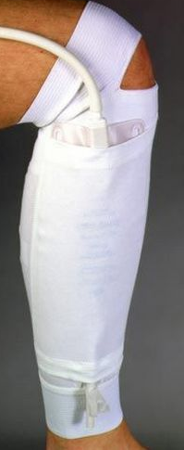
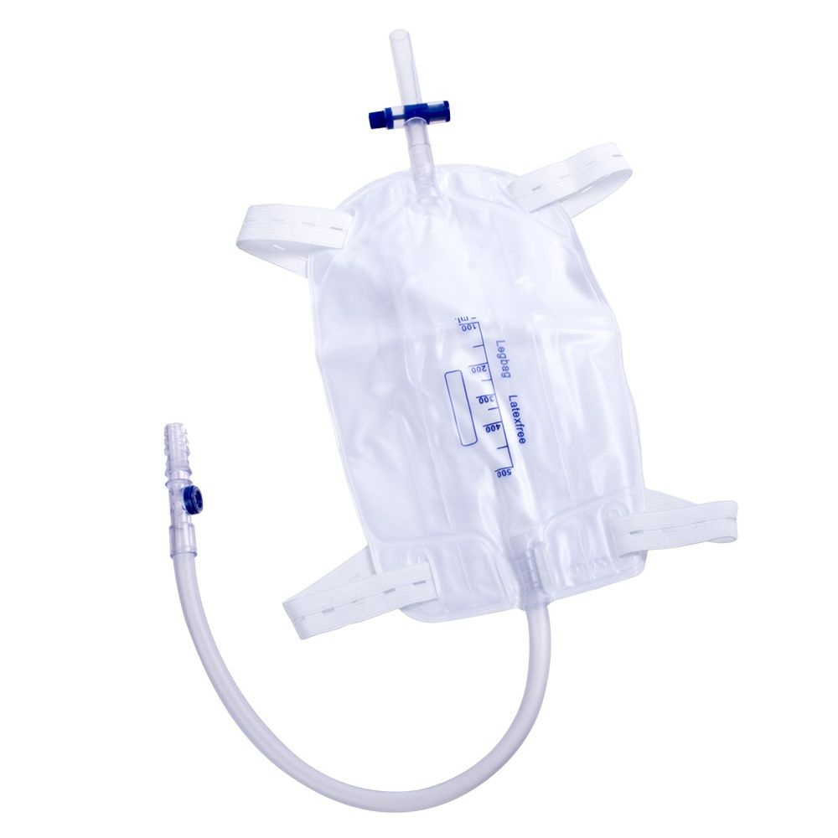
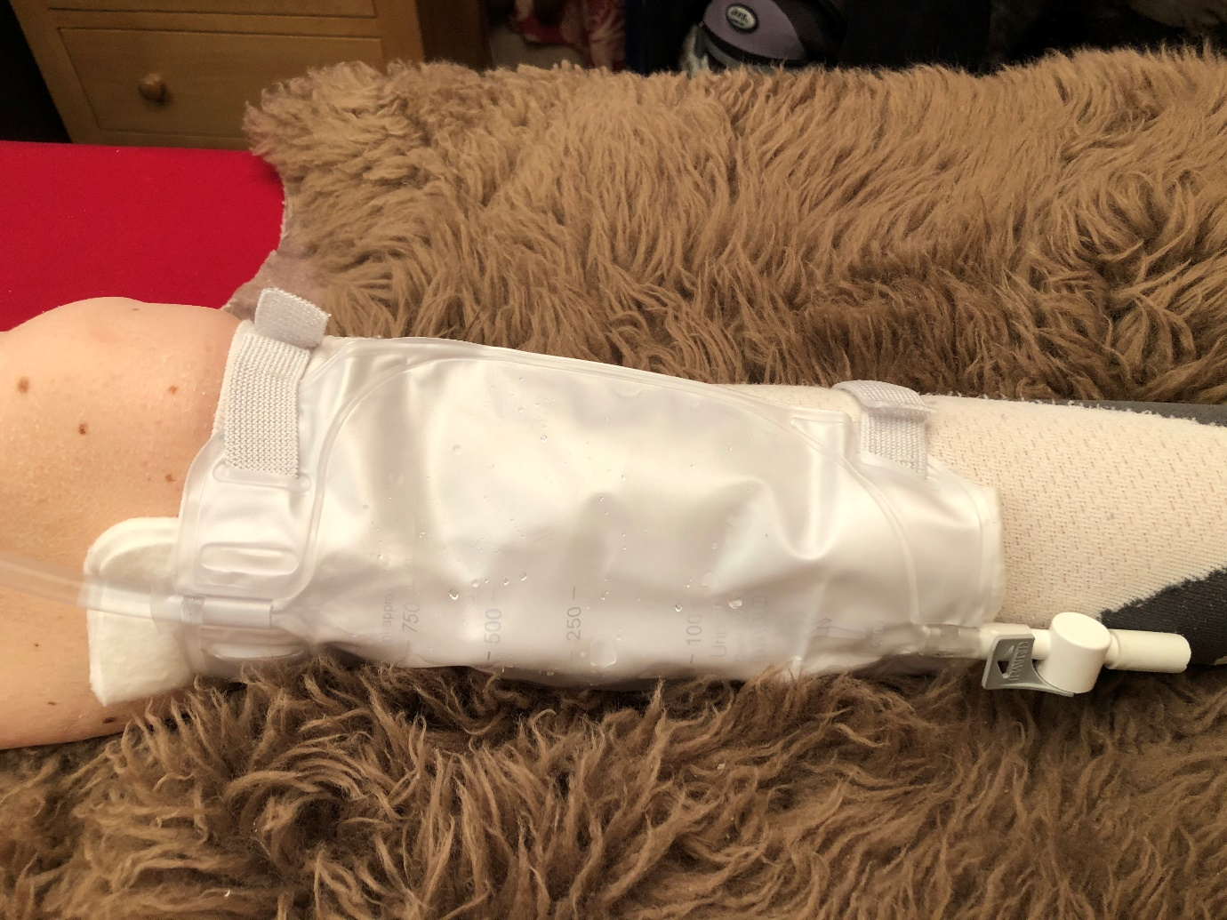
Leg Bags
Leg Bag Attached To Leg

Slide 10
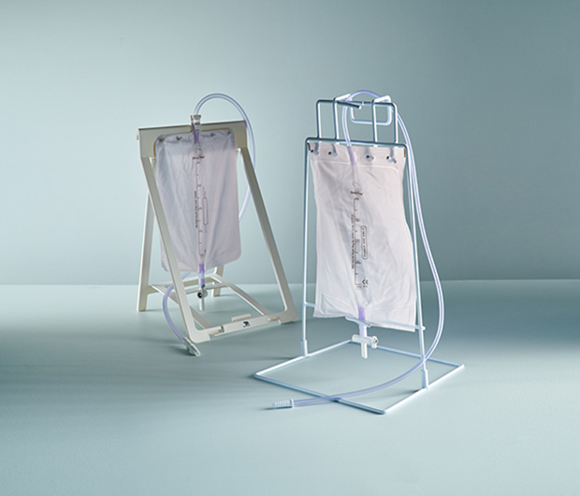
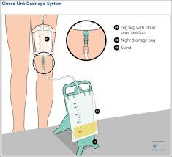
Night Bag & Stand

Slide 11

Hydration
Water makes up two thirds of our body. It is vital we drink enough fluid to maintain a healthy balance. Many people get dehydrated by not drinking enough fluid or by losing fluids and not replacing them.
Good hydration prevents :
urinary tract infections (UTIs)
headaches
constipation
dizziness
confusion
kidney stones
pressure ulcers/skin conditions
poor health
If your client is ill, particularly with a fever, vomiting or diarrhoea, there's a high risk of becoming dehydrated, so it's important to start replacing fluid as soon as possible.

Slide 12

Early Warning Signs of UTI
Cloudy urine, may have sediment or particles
Bad smelling urine
Blood in urine (haematuria)
Feeling unwell, confused or may have a Temperature
What to do :
Increase fluid intake
Collect urine sample
Take antibiotics (if prescribed)
Stop Clampping

Slide 13



